Slide 1
Draft schedule
-To create draft schedule, click draft schedule on the main registration page.

Slide 2
Select the correct term.

Slide 3
Select create a plan.

Slide 4
-Search for the desired courses, using the subject and course number.

Slide 5
-After you search, select the section you want in the plan.
-click and add the section from the desired class.
-After you finish plan, name and submit.
-you can have up to 5 plans.

Slide 6
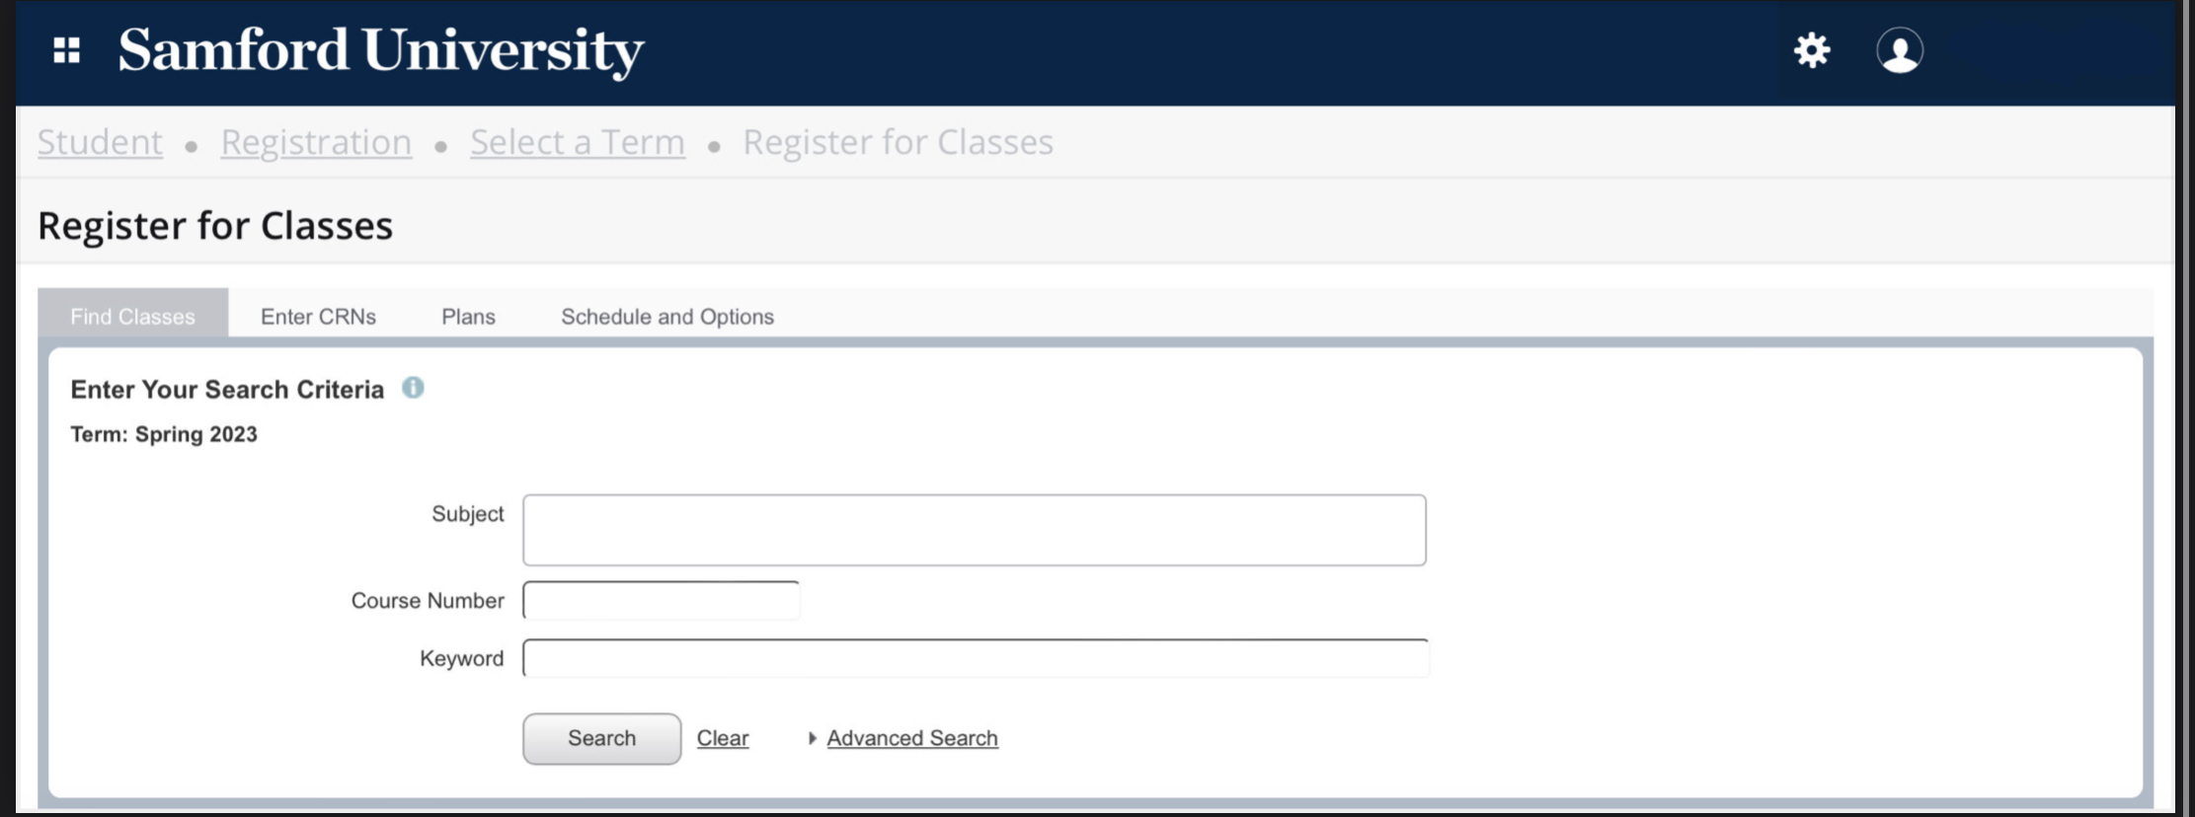
Draft plan for registration
-After entering registration pin, open the plans tab.

Slide 7
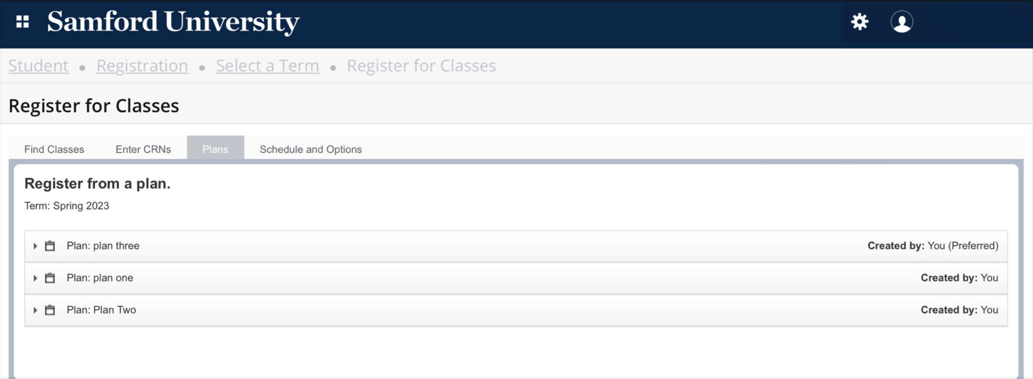
-You should be able to see all the plans you created.
-Select the plan you want.

Slide 8
-After you select a plan, this screen should pop up.
-To view section, click view sections.
-To add to your schedule press add.

Slide 9
-Once you add the classes you want, review you schedule, and press submit.

