Slide 1



Microsoft Bookings Tutorial
An easy way to schedule your advising appointments.

Slide 2
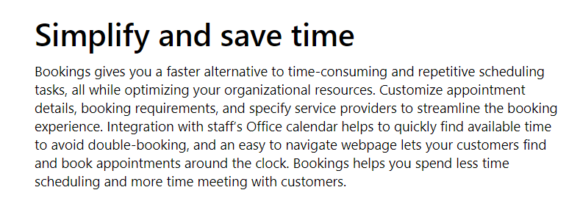

What are the benefits of using Microsoft Bookings?
Better integration across Samford’s campus since Microsoft Bookings is within the Office 365 platform.
Students can book appointments 24/7.
Students can view availability, book appointments themselves, and receive confirmations automatically.
Once an appointment is made by the student, the date is automatically added to your calendar. (Outlook and Google calendar are both supported.)
Reduction in no-show appointments, as automated appointment reminders are sent to students.
Ability manage your calendar from anywhere using mobile app.
Bookings is available as an app within Teams, which allows you to schedule and manage appointments without ever leaving Teams.

Slide 3
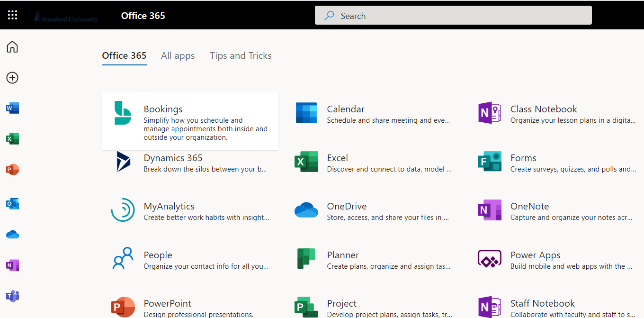
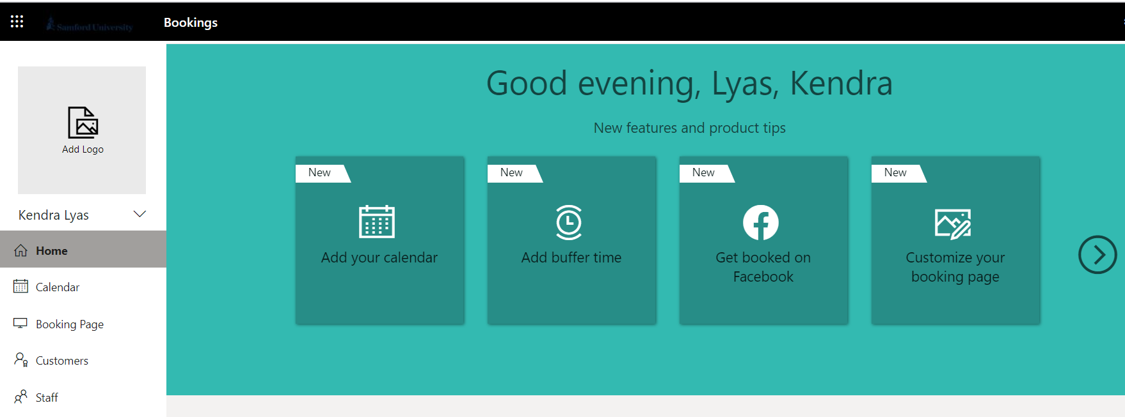
How to access Microsoft Bookings from Samford Employee Portal
1
Go to the Employee Portal and click on Office 365.
2
In the bottom left hand corner of the screen, click on All Apps.
3
Click on Bookings and select Get it Now. When prompted to “choose a calendar,” click Add a Booking Calendar.
Enter your first and last name as “business name” and press Continue. You will receive a welcome message (i.e. ”Goodevening, Lyas, Kendra!)
4

Slide 4
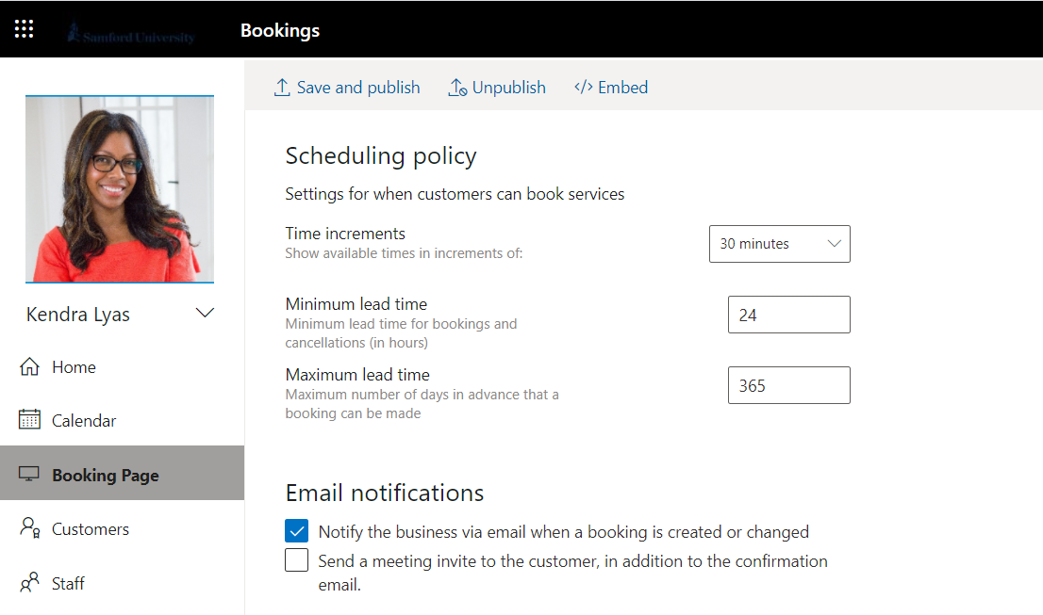
How to set your policies and logo
1
Click on the Bookings app and select Booking page in the navigation pane on the left.
2
Select your policies under the Scheduling policy section.
3
Select Save and publish.
To add a picture or Samford/Howard College logo, click on Add logo above the navigation pane. You may also update your time zone, color theme, and other features on this page.
4

Slide 5
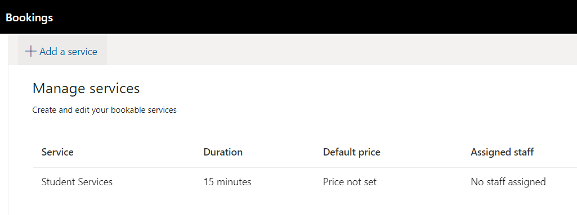
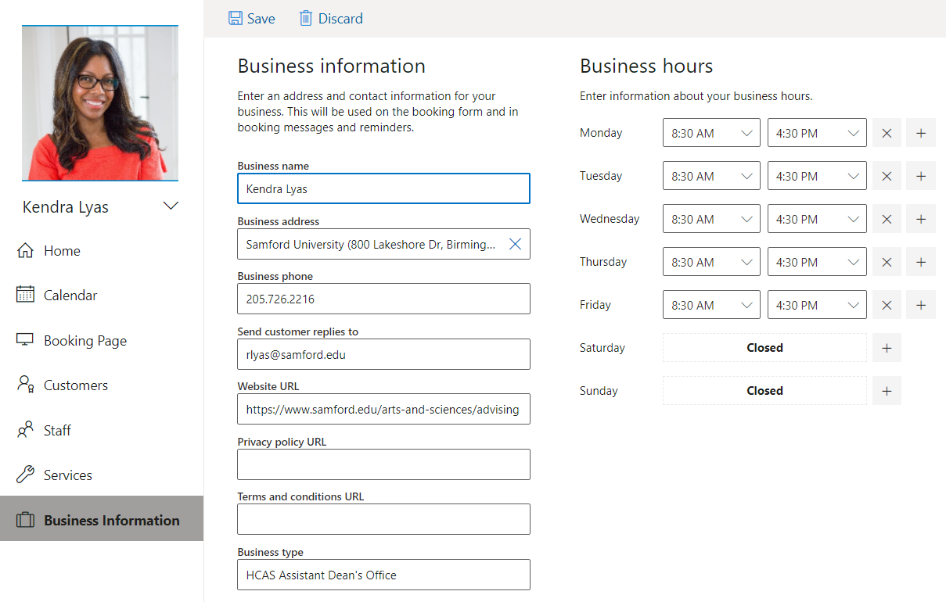
Finish setting up your page and publish
Click on Services in the navigation pane on the left. Click on the edit (pencil) icon to the right and type “Advising” or “Student Meeting” for service name. Enter the duration and press save.
1
2
Click on Business Information in the navigation pane on the left. Enter all fields including your business (office) hours and press save.
3
When you are ready to publish your booking page, select Save and publish.
Click on Booking page in the navigation pane on the left. Share your page by clicking the “share via email” symbol or pressing “copy” and composing an email with link to your advisees.
4

Slide 6
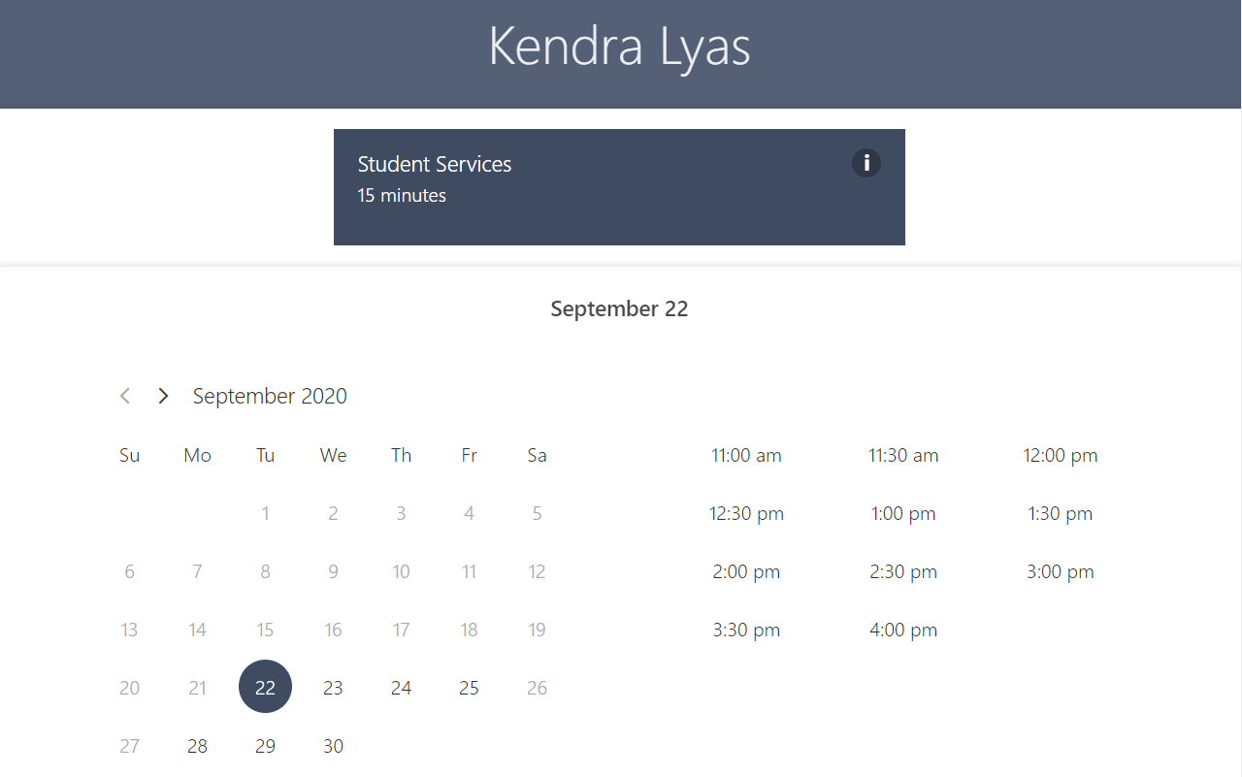
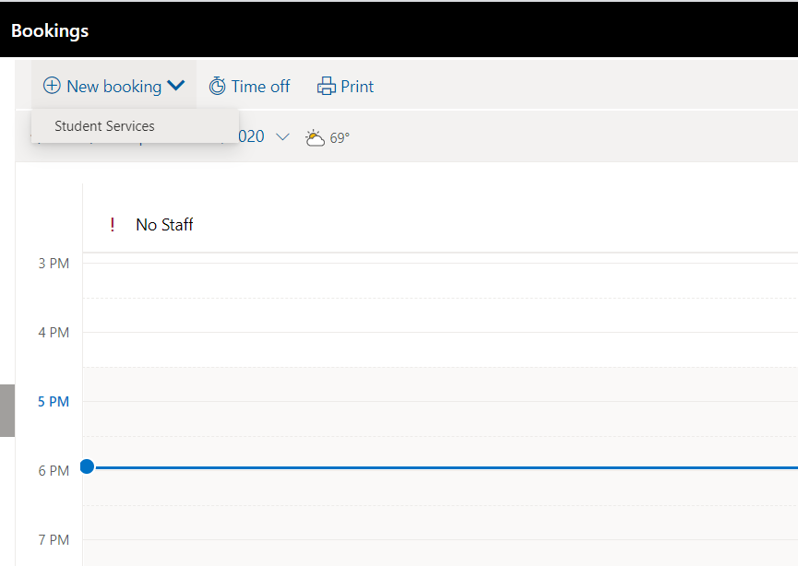
How students see your availability
1
Using the link to your page, students will see your calendar as shown on the right.
2
Students can see your availability and choose the day and time they would like to meet with you.
3
You can also schedule appointments for students by clicking on Calendar in the navigation pane, clicking on New Booking, and filling out all fields.
4
CONGRATULATIONS! You are now ready to start booking advising appointments with your students!

Slide 7


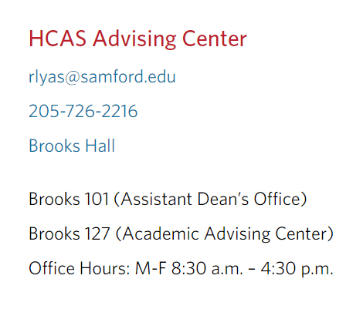
More questions about Microsoft Bookings?
Contact Kendra Lyas at rlyas@samford.edu or ext. 2216.
Visit the HCAS Advising Website:
https://www.samford.edu/arts-and-sciences/advising
Visit the Microsoft Bookings Website:
https://www.microsoft.com/en-us/microsoft-365/business/scheduling-
and-booking-app
Notes:
In Slide Show mode, select the arrows to visit links.

