Slide 1


Slide 2
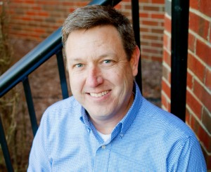

Fundraising For Impact
Game Changing Principles for Building a Partnership Team
Chris Blazer, Senior Coach
Tailored Fundraising Solutions

Slide 3

Perspective: Where is the Focus?
Philippians 4:10-20

Slide 4
Model focused on Missionary

Slide 5
Model Focused on Impact

Slide 6
How to Stay Focused

Slide 7
Engaging Others for Impact

Slide 8
Awareness
Burden (passion/calling)
Challenge/Problem (why is this important)
Mission/Solution (What am I committing to do)
Who am I working with (Organization & Purpose)

Slide 9
Interest: Who Me?
How do I know if they are interested?
You Ask….

Slide 10
Evaluation: Invitation to Partner
Why (Personal and Kingdom Reasons)
What are we going to do and how will we know when it is accomplished
Who will we be working with
How will we determine if we are making progress
Your Role (not job description)
Their Role (Be Specific)

Slide 11
Keys to an effective face to face meeting
Keep it short, 20 minutes
Make it personal ,don’t just share general statistics, illustrate impact and need with a story
Lose the ministry lingo and Jargon
Make a clear call to action (invitation to partner)
Ask for Next Steps (follow-up)

Slide 12
Keys to an Effective Invitation to Partner
Invite don’t challenge or Manipulate
It’s not about need, but Impact—how will my partnership unlock opportunities for impact
Ask them to Commit
Ask for specific amount (or range)—implies you share the goal.
Communicate a timeframe for you to complete your goal

Slide 13
Decision: Clarify and Confirm
Thank You for taking the time to meet…I wonder if you had any other questions from our time together?
Would You like to partner?
How would you like to Give?
When would you like to start?
****if applicable frequency (annual, monthly, quarterly)

Slide 14
Involvement: Engaged
Thank you
Communicate how are making a difference together (don’t give generic thank you—make it specific)
Verify with office that the gift is entered correctly in the system

Slide 15

Resources

Slide 16
For Further Reading:
Funding Your Ministry by Scott Morton
Funding The Family Business by Myles Wilson
The God Ask by Steve Shadrack
Everybody Writes, Your Guide to Creating Ridiculously Good Content by Ann Handley

