Slide 1

FALL DATA DAY
16 October 2024
Opening Session
10:00 – 12:00
OBB 232/233
Fac-Staff Lunch
12:00 – 1:00
ELC Commons

Slide 2
PRAYER
Dr. Tarsha Shepard
Opening Prayer

Slide 3
HDFS and Diversity
Dr. Celeste Hill

Slide 4
Key Ways Diversity is Addressed in HDFS
Cultural Competence
Social Contexts and Development
Intersectionality
Lifespan Perspective (including neurodiversity)
Family Structure and Diversity
Policy and Advocacy
Research and Practice

Slide 5
OPENING REMARKS
Dr. Anna McEwan
Committed to Diversity: Broadening Perspectives

Slide 6
OBSOE Enrollment & Recruitment
Mrs. Dana Mungenast
Mrs. Marcie Harchuck

Slide 7
Undergraduate Enrollment
Mrs. Dana Mungenast

Slide 8
Undergraduate
Enrollment Fall 2024
Admits
 | Fall 2024 | Fall 2023 | Fall 2022 | Fall 2021 | Fall 2020
 | 182 | 203 | 176 | 164 | 149
Program | YTD Vs 2023 | Stretch Goal | Fall 2024 | Fall 2023 | Fall 2022 | Fall 2021 | Fall 2020
HDFS | +9 | +6 | 28 | 19 | 22 | 11 | 15
ESEC | +4 | -10 | 19 | 15 | 23 | 29 | 29
ELMN | +1 | -4 | 19 | 18 | 23 | 12 | 7
Total ESEC/ELMN | +5 | -8 | 38 | 33 | 46 | 41 | 35
SEED | -8 | -8 | 6 | 14 | 10 | 9 | 9
Total Deposits |  |  | 72 | 70 | 76 | 61 | 60

Slide 9
Undergraduate
Entering Freshman Fall 2024
Undergraduate Enrollment Updates by State
State | YTD vs. 2023 | Fall 2024 | Fall 2023 | Fall 2022 | Fall 2021 | Fall 2020
AL | -7 | 15 | 22 | 17 | 25 | 14
GA | met | 18 | 18 | 19 | 11 | 20
TN | +8 | 15 | 7 | 14 | 8 | 10
FL | -2 | 5 | 7 | 10 | 5 | 3
TX | +3 | 8 | 5 | 3 | 3 | 3
NC | +1 | 1 | 0 | 1 | 3 | 2
SC | -2 | 1 | 3 | 1 | 5 | 3
MI | +1 | 1 | 0 | 0 | 0 | 0
MS | +1 | 1 | 1 | 0 | 0 | 1
LA | +1 | 1 | 0 | 0 | 1 | 1
KY | +1 | 1 | 0 | 1 | 1 | 1
AZ | +1 | 1 | 0 | 0 | 0 | 0
CA | +1 | 1 | 0 | 0 | 0 | 0
CO | +2 | 2 | 0 | 0 | 0 | 0
HI | +1 | 1 | 0 | 0 | 0 | 0
OH | 0 | 0 | 0 | 0 | 0 | 0
Total | 63 (2023) | 72 | 63 | 66 | 62 | 58

Slide 10
Undergraduate
Entering Freshman Comparative
Samford University
 | Freshman Class | Transfers
Fall 2024 | 1087 | 245
Fall 2023 | 1089 | 75
Fall 2022 | 972 | 2
Fall 2021 | 918 | 4
Fall 2020 | 971 | 4

Slide 11
Undergraduate
Enrollment Fall 2024
Transfers
 | Fall 2024 | Fall 2023
Continuing Studies | 10 | 4
HDFS | 1 | 2
Teacher Education | 11 | 1

Slide 15
Teacher Education
Undergraduate Enrollment
Mrs. Dana Mungenast

Slide 16
Undergraduate

Slide 17
Undergraduate

Slide 19
Undergraduate
Teacher Education Fall 2024 Gender

Slide 20
Undergraduate
Teacher Education Race Comparison
Fall 2024

Slide 21
HDFS
Undergraduate Enrollment
Mrs. Dana Mungenast

Slide 22
Undergraduate - HDFS

Slide 23
Undergraduate - HDFS

Slide 24
Undergraduate - HDFS

Slide 25

HDFS
30 %

Slide 26
Human Development & Family Science
Gender Comparison
Undergraduate - HDFS

Slide 27
Undergraduate - HDFS
Human Development & Family Science
Race Comparison

Slide 28
Undergraduate
Fall 2024
Undergraduate | Recruitment Activities
Williamson Co. College Fair Nashville, TN | Birmingham National Association for College Admission Counseling Fair
Preview Days | Walker Co.
Prospective Student Visits | Thompson High School Education Academy Advisory Council and District Meeting

Slide 29
Graduate
Mrs. Marcie Harchuck

Slide 30
Graduate
Fall 2024 Graduate Admission Stats
Summer 2024 Graduate Admission Stats
EDD n/a
EDS 3 new admits
MSE/CER INLD 14 new admits
Alt. A (Summer) 10
EDD 11 new admits
EDS 2 new admits
MSE/CER INLD 11 new admits
MASE ORLD 13 new admits

Slide 31
Graduate

Slide 32
Graduate

Slide 33
Graduate
Spring 2024 Gender Comparison

Slide 34
Graduate
Spring Race Comparison

Slide 35
Graduate - Graduation
Graduate Program | Completing Fall 2024
Ed.D Educational Leadership | 13
Ed.S Instructional Leadership | 1
MSE Instructional Leadership | 4
CER Instructional Leadership | 4
Alt. A | 7
Totals | 29

Slide 36
Recruitment Team Update
The Recruitment Team that includes all members of the Dean’s Council continues to meet.
The Dean’s Council meets monthly to discuss updates in each department, biannually review the School’s recruitment plan, and offer suggestions for revisions as well as monitor recruitment efforts and update target enrollment numbers.

Slide 37
Graduate
Spring/Summer/Fall
Recruitment Activities
RECRUITMENT ACTIVITIES | DATES
ALA-CASE Conference | February 2024
CLAS Conference | June 2024
SSA Summer Conference | June 2024
SSA Fall Conference | October 2024
Graduate Admission Meetings | Year-round
ALT-A Open Houses | November, February

Slide 38
Graduate
Fall 2024 Graduate Recruitment Activities
Jane Cobia, Kara Chism, Bill Cleveland, Monique Witherspoon
Current 18-hr and MSE-IL School Partnership Cohorts:
Jefferson County
Birmingham City (2)
Trussville City
Mountain Brook
Limestone County

Slide 39
Graduate
Fall 2024 Graduate Recruitment Activities
Cullman County: October 10- Jane/Kara for a Spring MSE and EdS cohort
Hoover City: October meet with superintendent- Jane/Kara for a Spring MSE and to add EdS and EdD
Mt. Brook City- second group in summer I. Interest meeting in Oct/Nov.
Limestone City- October 2 virtual meeting for EdS Fall 2025
St. Clair County- Jane to set up fall meeting
Visit current MSE students- Lisa, Marcie, Bill, Monique
Birmingham City Schools- October 9
Trussville City- October 23
Mt. Brook City- October 23
Jefferson County- November 4
New Districts to approach for cohorts:
Huntsville City- (Jane)
Madison County- (Jane)
School for Cybertechnology- (Bill)
North Alabama- (Les)
Fairfield, Midfield, Tarrant City- (Bill) (Monique)
Marengo County- (Bill)- after SSA Conference
Enterprise and Ozark-(Bill)

Slide 40
Graduate
Fall 2024
Alt A Recruitment Activities
Mandy Hilsmier, Kameron Brown and Dana Mungenast
Meetings with senior seminar classes
Campus wide email flyers
Open House Event
Google Ad Campaign
Graduate Admissions email and text campaign for juniors and seniors

Slide 41
TEACHER EDUCATION
Sophomore Service Learning
Partnerships
Diversity Education
Diversity Forum 2024
Diversity in EDUC 326 – Elem Mathematics
Penn State Partnership
Dr. Kate Scarborough
Mrs. Melissa Wallis
Dr. Mandy Hilsmier

Slide 42
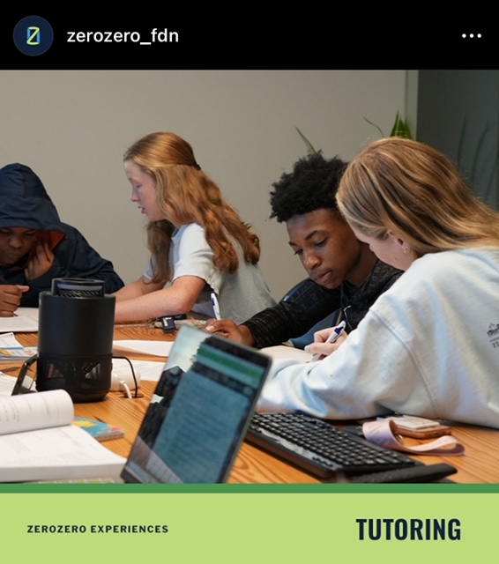
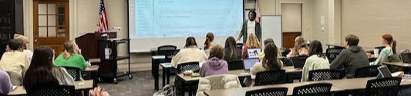
Teacher Education
Teacher Education
Sophomore Service Learning
ZeroZero Foundation Partnership
-Began in EDUC 202 and has evolved into a service-learning partnership for all teacher education majors through EDUC 200 course.
-ZeroZero provides support to children and families from diverse communities in the Birmingham area through sports and recreational activities, academic tutoring, and family mentoring. According to the founder of the organization, roughly 95% of their students are African American or Hispanic and live in traditionally underserved communities such as Avondale, Titusville, Eastlake, Woodlawn, Irondale, Clay-Chalkville, Fairfield, and Bessemer.
-Samford Teacher Education students provide mentorship by facilitating the academic tutoring sessions for students at ZeroZero on a weekly basis.
Link to Website: https://www.zerozerofoundation.org/about-us/about

Slide 43
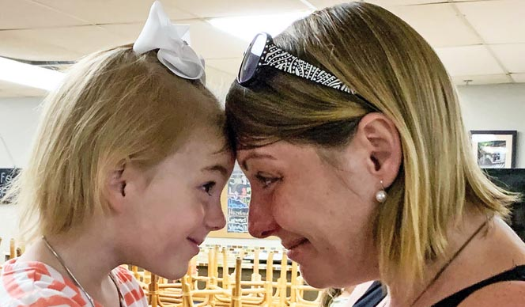
Teacher Education
Teacher Education
Sophomore Service Learning
Lovelady Center Partnership
-A service-learning partnership for all teacher education majors through EDUC 200 course.
-The mission of Lovelady Center is: Empowering women through Christ-centered initiatives so they can return to society as well-equipped women of God. The program is about empowerment, hope, and a belief in the value of every human life.
-Samford Teacher Education students provide a variety of service from tutoring, childcare, meal preparation and service.
-As teachers, our students will serve student populations similar to who is served at Lovelady. We are grateful for a partner who models the commitment to learners by valuing every human life.
Link to Website: https://www.loveladycenter.org/

Slide 44
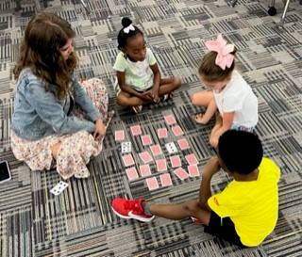
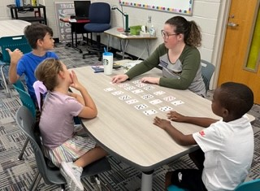
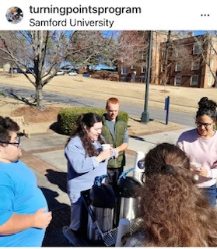
Teacher Education
Teacher Education Partnerships
Turning Points - students are engaged with individuals with exceptionalities through the partnership with Turning Points
Homewood Middle School – Junior Secondary students attend Samford courses onsite and participate in classroom and school wide events. HMS serves grades 6-8 from diverse backgrounds; 30% free and reduced lunch; 65% white, 16% black, 13% Hispanic, 2% Asian or Pacific Islander; serves students with variety identified learning disabilities
Trace Crossings – Junior ESEC/ELMN students attend Samford courses onsite and participate in classroom and school wide events. TCES is a Title 1 school serving a diverse student population grades P-5; 41% white, 34% black, 10% Asian or Pacific Islander, 8% Hispanic; serves students with identified learning disabilities

Slide 45

Teacher Education
Examples of Assignments that support Diversity Education in Teacher Education
Alabama Disproportionality Training in Special Education (Lee v. Macon)- in EDUC 202 and EDUC 402, undergraduate students receive training related to disproportionality and bias in special education referral and assessment procedures.
Poverty Simulation - in partnership with HDFS, Micah Fellows, and The School of Public Health, students become more aware of common experiences among people living in poverty
Literacy Action Research - The purpose of the assessment is to systematically address specific literacy needs among students through a research-based action plan emphasizing the principles of the Science of Reading.
Math Tutoring – Teacher education students provide intensive, systematic instruction in math to students identified as struggling. Students and their needs are identified by collaborative review of assessment data of our partner school.

Slide 46
The 2024 Diversity Forum
June 4, 2024
Theme: Supporting Individuals with Exceptionalities
Keynote: Joy Winchester, Empathy in Inclusive Classrooms
Sessions included topics such as:
Behavior management, literacy and math updates from the state, mindfulness in the classroom, conscious discipline, accommodations in higher education, technology enhanced classrooms, etc.
Over 55 people registered and about 45 participants attended the event!
Link to article: Samfords-School-of-Education-Hosts-3rd-Annual-Diversity-Forum
Stay tuned for details regarding the 2025 Diversity Forum to be held June 2025! The theme this year will likely be focused on socio-economic diversity or religious diversity.

Slide 47
Teacher Education
Diversity in EDUC 326 – Elem Mathematics
Diversity through Differentiation
Differentiation is a teaching approach that supports diversity in the classroom by acknowledging that students have different needs and abilities, and that everyone has the right to an education that meets those needs.

Slide 48

Teacher Education
Key Assessment:
Tutoring Assessment
Math coach PD
Mathematics reflection, interest survey/baseline data
TIER 3 documentation forms (3 forms-intervention activities, assessment documentation, student planning page)
Parent communication letter (progress report)
Mock data meeting
Work samples

Slide 49
Teacher Education
3 students per Samford student
Varying levels of math literacy
How does this tie into diversity?
Tracking student progress
A, V, K learners- this is stressed in our class
Managing multiple proficiencies at once and how to teach heterogeneously
Diversity in small group management-different behaviors spread throughout

Slide 50
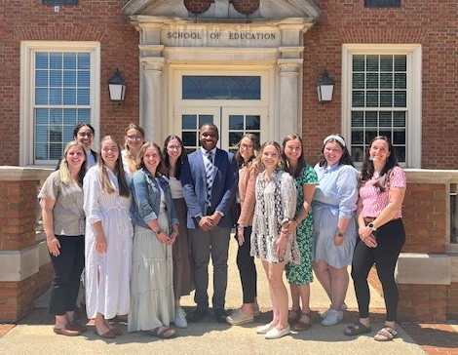

Teacher Education
Penn State Partnership: Difficult Conversations
10 Undergraduate seniors were invited to participate in the Penn State partnership in Fall 2023
Students committed to participate in one all day training and then zoomed every 2 weeks with the trainers on how to have difficult conversations around difficult topics for the remainder of the school year
Each student selected a difficult topic to investigate and implement during their internship semester
At the oral presentation for all graduating seniors, those who participated in the difficult conversations’ cohort completed a presentation on their difficult topic and the experience implementing the conversation in their internship classroom. The Penn State trainers came to campus for the presentations.

Slide 51
Teacher Education
Effective ways to increase student engagement
Integrating social emotional learning into instruction
Trauma informed instruction: creating safe spaces
Examples of Difficult Conversation Topics from Spring 2023:

Slide 52


