Slide 1

Spring DATA DAY
Technology in Action
07 May 2025
Opening Session
10:00 – 12:00
OBB 232/233
Fac-Staff Lunch
12:00 – 1:00
ELC Commons

Slide 2
Dr. Anna McEwan
Welcome

Slide 3
Dr. Monique Witherspoon
Opening Prayer

Slide 4
Dr. Anna McEwan
School of Education Updates

Slide 5
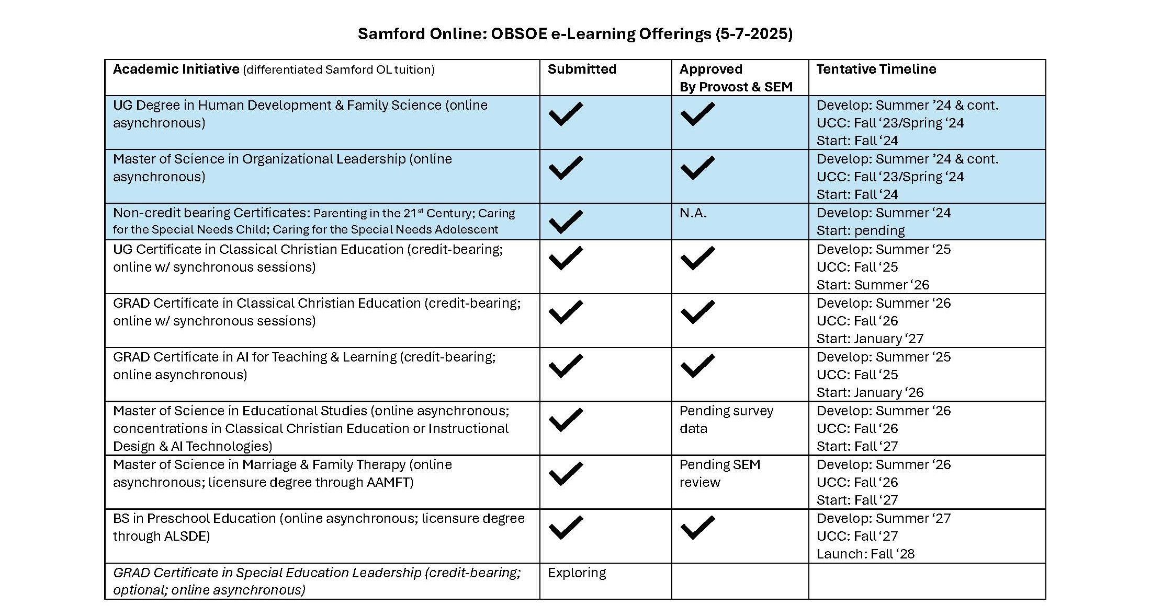

Slide 6
Organizational Changes for
‘25-26
Leadership Team: 5 members
Karen Birkenfeld
Kristie Chandler
Amy Hoaglund
Anna McEwan
Monique Witherspoon
Leadership Team: 7 members
Karen Birkenfeld
Kristie Chandler (Samford OL/OBSOE e-Learning)
Kara Chism (EDLD)
Celeste Hill (HDFS)
Amy Hoaglund
Anna McEwan
Monique Witherspoon

Slide 7
OBSOE Enrollment & Recruitment
Dr. Monique Gardner Witherspoon
Mrs. Dana Mungenast
Mrs. Marcie Harchuck

Slide 8
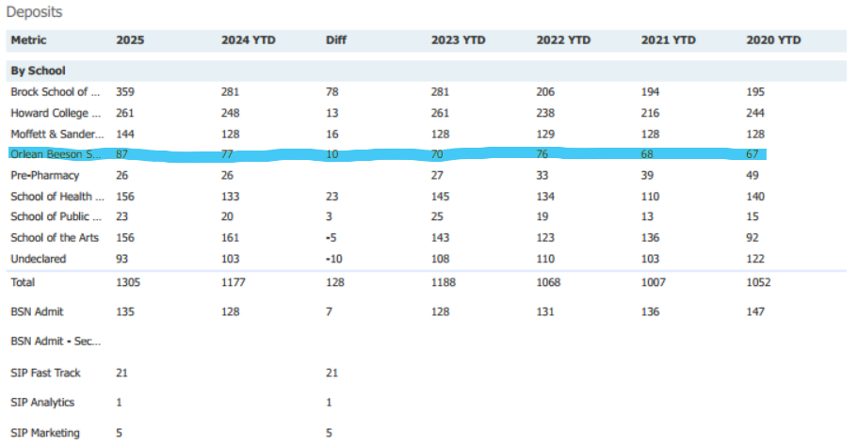

Slide 9
Undergraduate
Entering Freshman Comparative University Totals
Samford University
 | Freshman Class | Transfers | Total
Fall 2025 | 1216 (5/5/25) | 54 | 1270
Fall 2024 | 1087 | 245 *Bham Southern | 1332
Fall 2023 | 1089 | 75 | 1083
Fall 2022 | 972 | 2 | 974
Fall 2021 | 918 | 100 | 1018

Slide 10
Undergraduate Enrollment
Mrs. Dana Mungenast

Slide 11
Undergraduate
Enrollment Fall 2025
Admits
Metric | YTD vs. 2024 | Fall 2025 | Fall 2024 | Fall 2023 | Fall 2022 | Fall 2021 | Fall 2020
Admits | +38 | 220 | 182 | 203 | 176 | 164 | 149
Deposits compared to YTD Deposits 2024
Metric | YTD vs. 2024 | 5/5 | 4/27 | 4/21 | 4/14 | 4/7 | 3/31 | 3/24 | 3/17 | 3/10 | 3/3 | 2/24 | 2/17 | Fall 2024 | Fall 2023 | Fall 2022 | Fall 2021 | Fall 2020
Deposits | +10 | 87 | 87 | 84 | 80 | 79 | 80 | 80 | 77 | 77 | 75 | 73 | 70 | 77 | 44 | 54 | 46 | 45
Deposits compared to Institutional Data Fall 2024
Metric | YTD vs. 2024 | 5/5 | 4/27 | 4/21 | 4/14 | 4/7 | 3/31 | 3/24 | 3/17 | 3/10 | 3/3 | 2/24 | 2/17 | Fall 2024 | Fall 2023 | Fall 2022 | Fall 2021 | Fall 2020
Deposits | +17 | 87 | 87 | 84 | 80 | 79 | 80 | 80 | 77 | 77 | 75 | 73 | 70 | 70 | 44 | 54 | 46 | 45

Slide 12
Undergraduate
Enrollment Fall 2025
Program | YTD Vs 2024 | Fall 2025 | Fall 2024 | Fall 2023 | Fall 2022 | Fall 2021
HDFS | +2 | 26 | 24 | 19 | 22 | 11
ESEC | -1 | 18 | 19 | 15 | 23 | 29
ELMN | +6 | 30 | 24 | 18 | 23 | 12
Total ESEC/ELMN | +3 | 48 | 43 | 33 | 46 | 41
SEED | +7 | 10 | 3 | 14 | 10 | 9
Total TE | +10 | 58 | 46 | 47 | 56 | 50
Total Deposits | +14 | 84 | 70 | 70 | 76 | 61

Slide 13
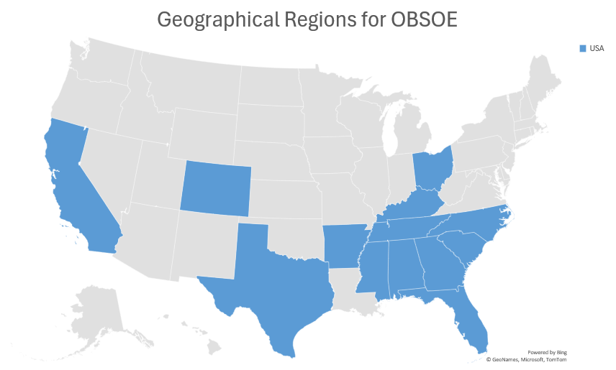
Undergraduate
Entering Freshman Fall 2025

Slide 14
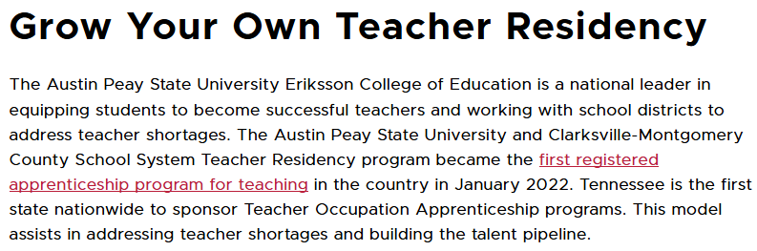

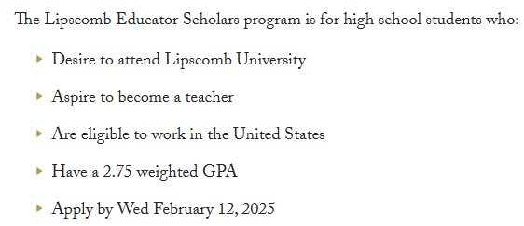
What is the Tennessee Future Teacher Scholarship?
Overview: The Tennessee Future Teacher Scholarship is a loan-scholarship program intended to encourage exemplary students to enter the teaching field in Tennessee. Participation is limited to college juniors and seniors admitted to an approved educator preparation program (EPP) in a Tennessee college or university.

Slide 15



The Georgia Registered Teacher Apprenticeship Program (GaRTAP)
offers an innovative pathway to become a certified K-12 teacher while earning a salary. Designed to address teacher shortages across Georgia, the program allows participants to “earn while they learn” by combining hands-on classroom experience, mentorship from experienced educators, and college coursework—all while working toward a bachelor’s degree and teaching certification.
pre-apprenticeships for high school students interested in becoming educators and assists with their transition into registered teaching apprenticeships after high school.
https://teachinthepeach.org/

Slide 16

Undergraduate
Enrollment Fall 2025
OBSOE
Yield
Funnel
 | Preview Day April 2024 | Preview Day April 2025
Attendees | 261 | 168
OBSOE Contacts | 23 | 21
Deposits | 13 Fall 2025 | Fall 2026

Slide 18
Teacher Education
Undergraduate Enrollment
Mrs. Dana Mungenast

Slide 19
Undergraduate

Slide 20
Undergraduate

Slide 22
Undergraduate
GRADE LEVEL Total 180 |  | Cohort GPA
SENIORS | n
ESEC | 14 | 3.62
ELEM | 11 | 3.42
SEED | 9 | 3.57
MUSIC | 3 | N/A
Total | 37 | 3.54
JUNIORS | n
ESEC | 14 | 3.78
ELEM | 11 | 3.62
SEED | 7 | 3.73
MUSIC | 4 | N/A
Total | 36 | 3.71
SOPHOMORES | n
ESEC | 23 | 3.69
ELEM | 16 | 3.38
SEED | 11 | 3.68
MUSIC | 6 | N/A
Total | 56 | 3.58
Freshman | n
ESEC | 24 | 3.68
ELEM | 20 | 3.29
SEED | 5 | 3.71
MUSIC | 2 | N/A
Total | 51 | 3.56

Slide 23
Undergraduate
Teacher Education Spring 2025 Gender

Slide 24
Undergraduate
Teacher Education Race Comparison
Spring 2025

Slide 25
HDFS
Undergraduate Enrollment
Mrs. Dana Mungenast

Slide 26
Undergraduate - HDFS

Slide 27
Undergraduate - HDFS

Slide 28
Undergraduate - HDFS

Slide 29
Undergraduate - HDFS

Slide 30
Undergraduate - HDFS
Spring Total | 202
Concentrations
Child Life | 19
Child Development | 5
Gerontology | 1
Majors
HDFS | 177

Slide 31
Undergraduate - HDFS
Fast Track | Students
Social Work | 25
3+3 LAW | 1
Divinity | 5
5/MBA | 1

Slide 32
Undergraduate - HDFS
Continuing Studies | Students
Human Development and Family Science BA 7

Slide 33
Human Development & Family Science
Gender and Race
Undergraduate - HDFS

Slide 34
Undergraduate
Spring 2025
Undergraduate | Recruitment Activities
Zoom Student Panels | FTA Conference
Preview Days | FCCLA Conference
Prospective Student Visits | Thompson High School Education Academy Advisory Council and District Meeting
Choose Samford | FTA Signing Days Homewood HS & Thompson HS
Homewood HS FTA Campus Visit

Slide 35
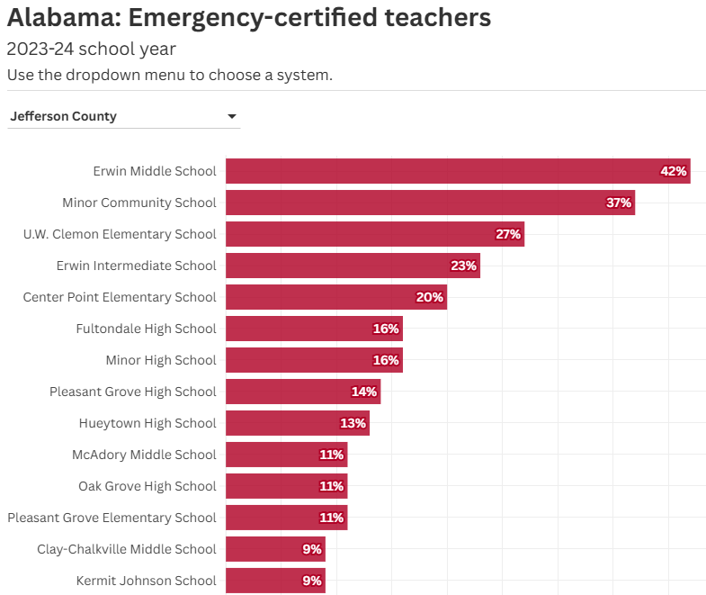
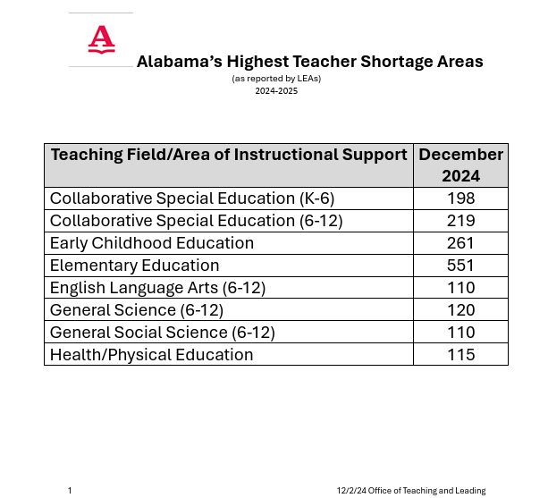
Source: Alabama Department of Education

Slide 36
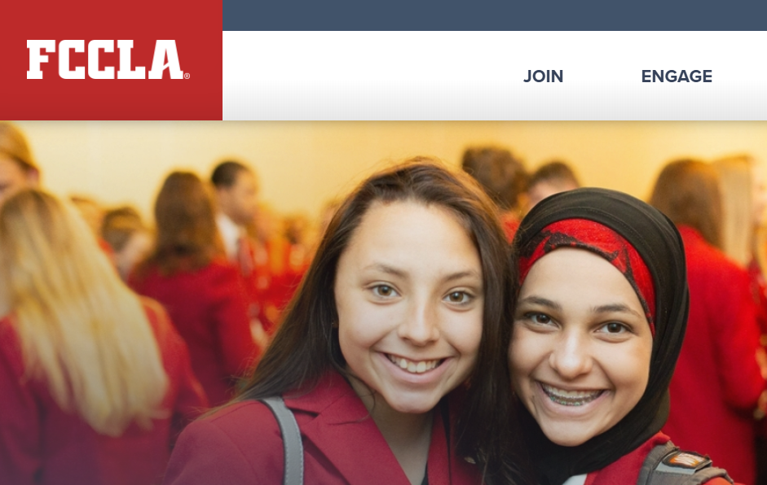
Source: Alabama Department of Education

Slide 37
Undergraduate
Spring 2025
Alternative Master’s | Recruitment Activities
Prospective Student Visits | Zoom Meetings
School of Arts and Science Class Visits | Small group meetings with undecided students
Spring Open House
Edgradadmit contacts
Coffee/Lunch

Slide 38
Graduate
Mrs. Marcie Harchuck

Slide 39
Graduate
Spring 2025 Graduate Admission Stats
Fall 2024 Graduate Admission Stats
EDD 11 new admits
EDS 2 new admits
MSE/CER INLD 11 new admits
MS ORLD 13 new admits
EDD 6 new admits
EDS 0 new admits
MSE/CER INLD 2 new admits
MS ORLD 0 new admits

Slide 40
Graduate

Slide 41
Graduate

Slide 42
Graduate - Graduation
Graduate Program | Completing Spring 2025
Ed.D Educational Leadership | 9
Ed.S Instructional Leadership | 1
MSE Instructional Leadership | 6
CER Instructional Leadership | 13
Alt. A | 0
Total | 29

Slide 43
Educational Leadership Department’s Enrollment Management
And Recruitment Efforts

Slide 44
Graduate Enrollment Management
Drop list trends/monitoring
Need-based financial help
The Dean’s Council and recruitment team meetings to discuss updates in each department, biannually review the School’s recruitment plan, and offer suggestions for revisions as well as monitor recruitment efforts and update target enrollment numbers.
School visits to enrolled students and alumni
Ed Lead Events - Baseball Game

Slide 45
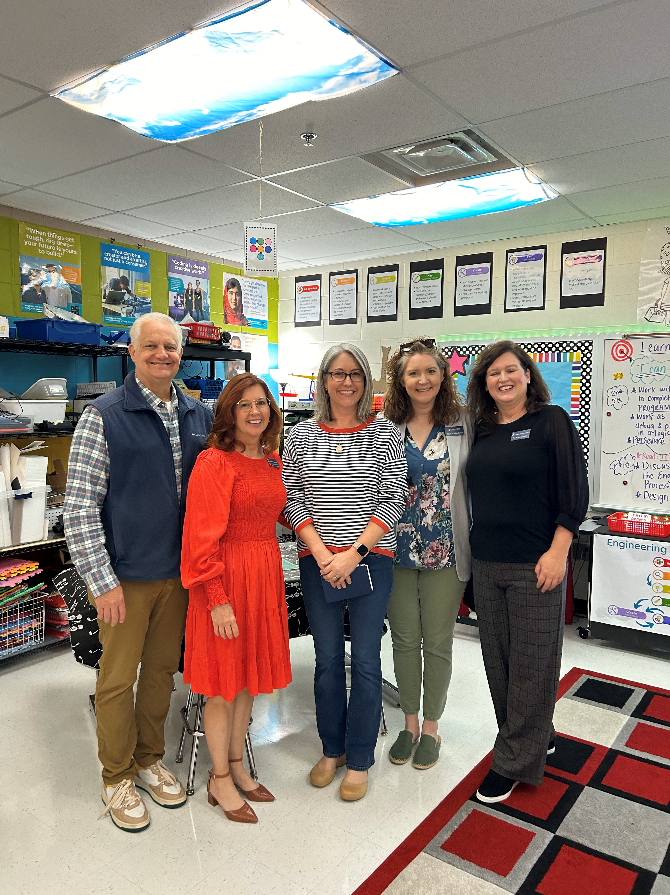
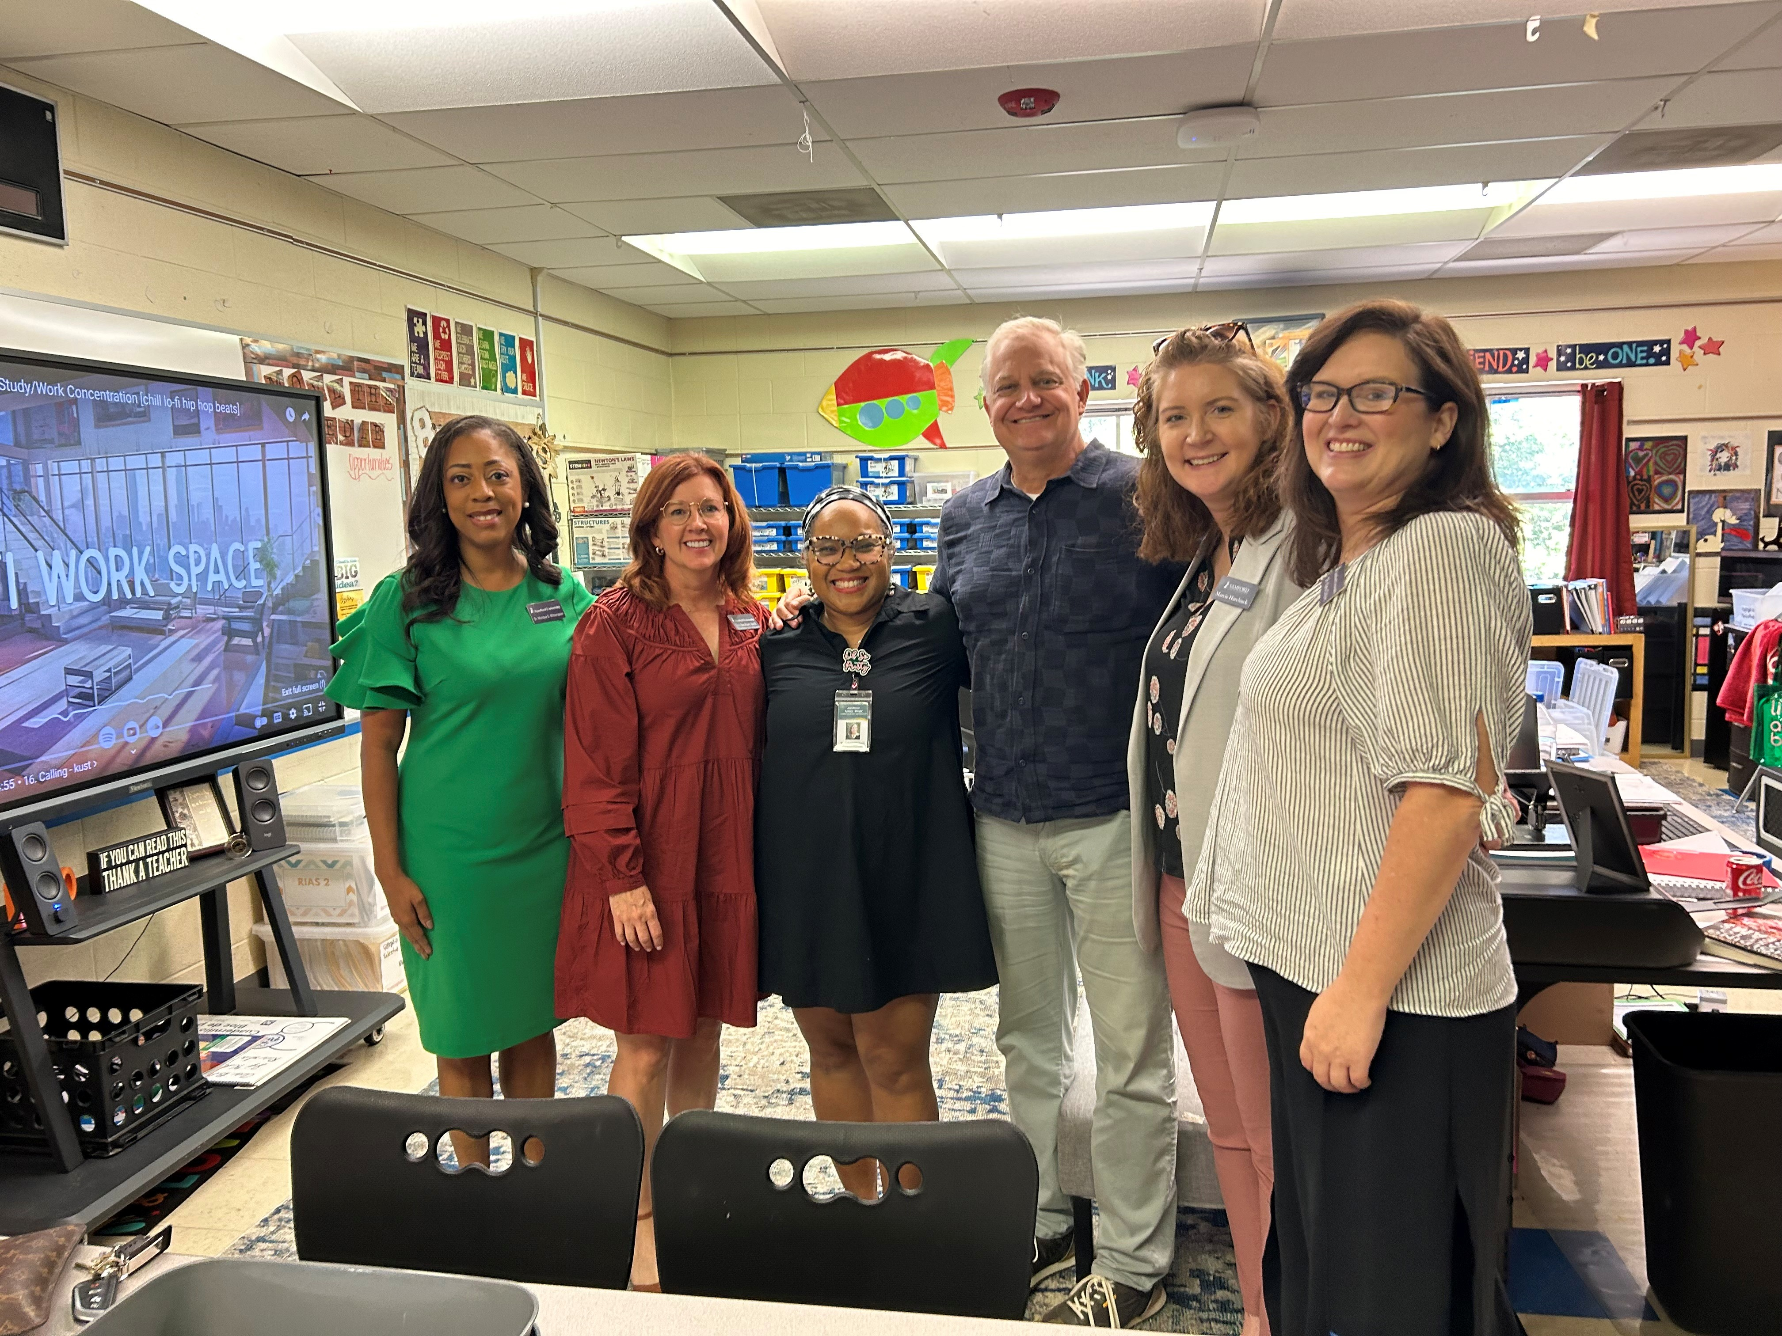
Graduate Enrollment Management
Personal visits to enrolled students/alumni to
build relationships,
promote engagement and provide additional
in-person support!
23 Schools/Central Offices
31 students/alumni

Slide 46
Graduate Recruitment
Spring/Summer/Fall
Conference Recruitment Activities
RECRUITMENT ACTIVITIES | DATES
ALA-CASE Conference | February 2025
CLAS Conference | June 2025
SSA Summer Conference | June 2025
SSA Fall Conference | October 2025
Faculty Visits | Year-round
Graduate Information Sessions | 12 total in 2024-2025

Slide 47
Graduate Recruitment
Faculty Visits in 24-25
Leeds
St. Clair County
Pell City
Birmingham
Jefferson County
Trussville
Hoover
Fairfield
Midfield
Bessemer
Tuscaloosa City
Tuscaloosa County
Sumter County
Marshal County
Limestone County

Slide 48
Graduate Admission Updates
Upcoming 18-hr and MSE-IL School Partnership Cohorts:
Jefferson County (2nd)
Birmingham City (3rd MSE; 1st EDS)
Hoover City
St. Clair County
Leeds City
Marshal County
Limestone County
Updates to Admissions:
Rolling interviews
Admission Work Sessions

Slide 49
Graduate Admission Updates
Graduate Admission Updates
Summer Admission Numbers as of April 29th:
Alt A – 13
MSE/CERT – 20
MSOL - 1
TOTAL – 34
Additional Summer Admission Numbers (projected):
MSE/CERT – 30
Fall Admission Numbers as of April 29th:
EDD – 10

Slide 50
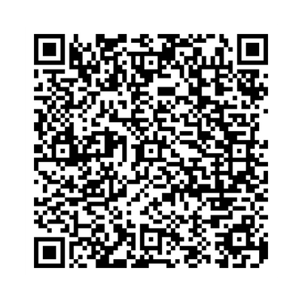
Enhancing Learning with Technology
Matt Wilson

Slide 51
LEARNING FIRST, TECHNOLOGY SECOND

Slide 52
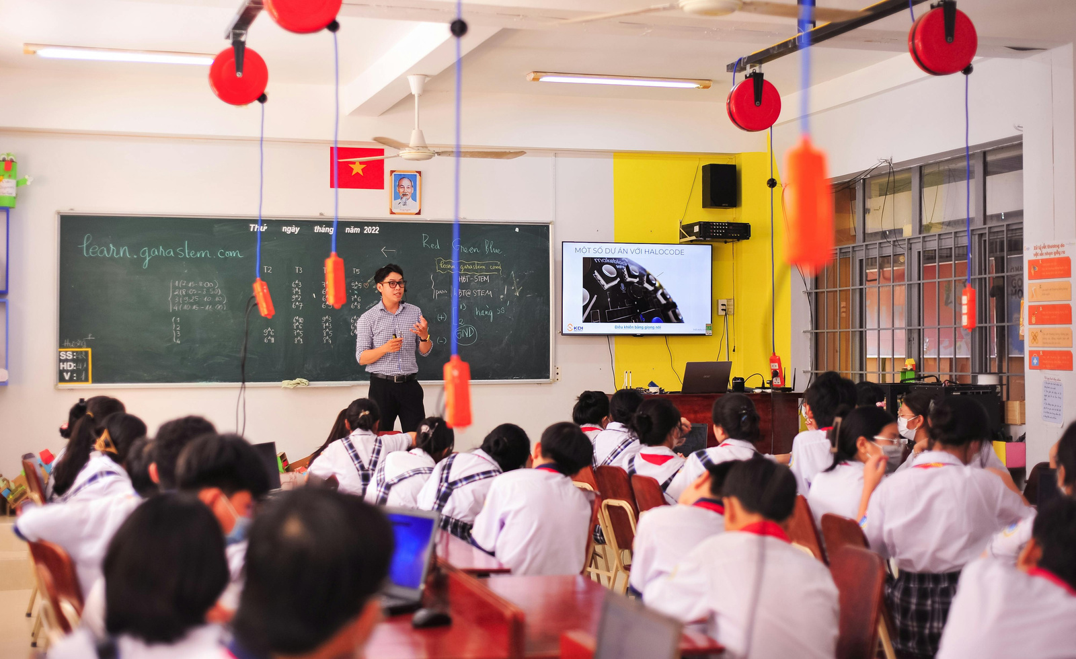





Slide 53
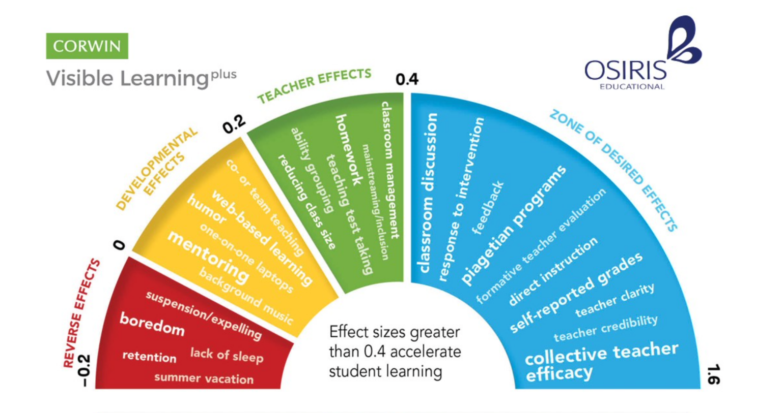
JOHN HATTIE

Slide 54
EDUC 521
Lectures = -0.41
Web Based Learning = 0.17
Online and Digital Tools = 0.36
Summarizing = 0.45
Concept Mapping = 0.66
Jigsaw Method = 0.92
Blended Learning = 0.85
Classroom Discussion = 0.82
Curiosity = 0.74
Feedback with Tech = 0.65

Slide 55



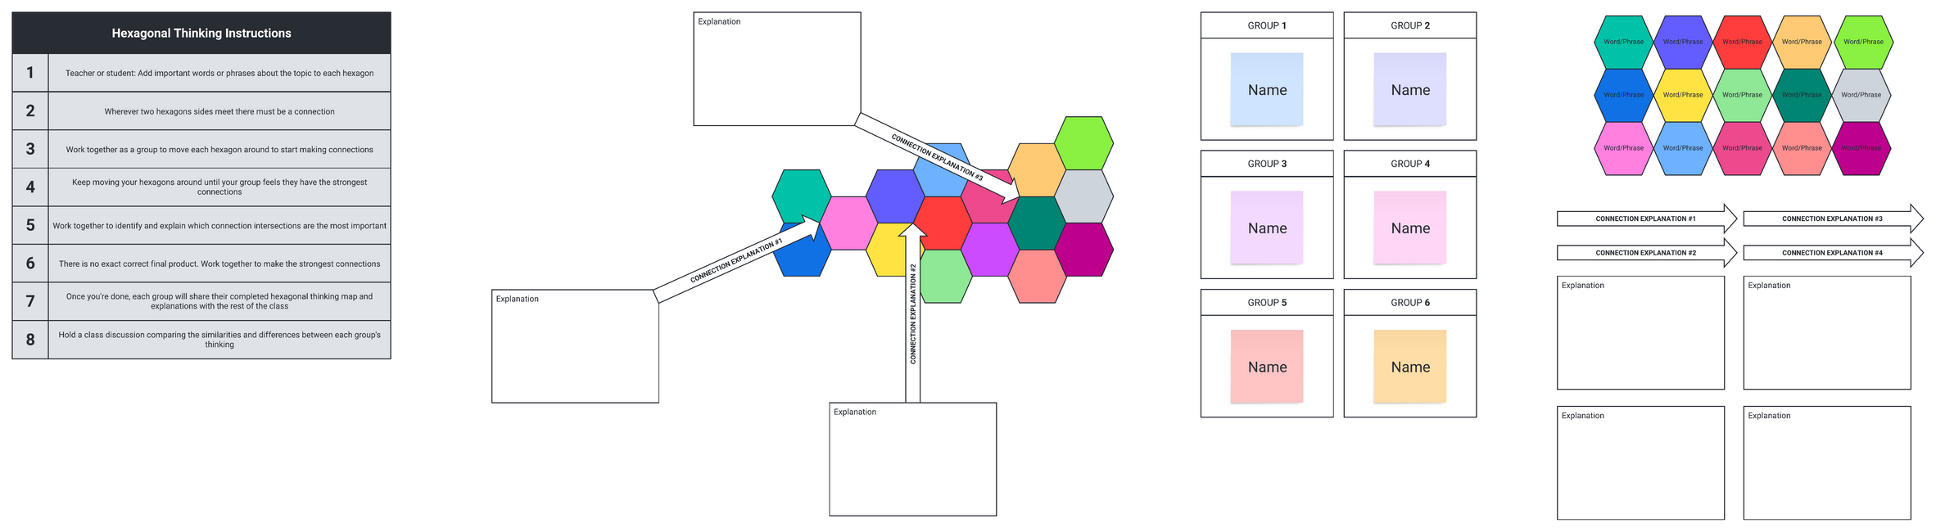

Slide 56


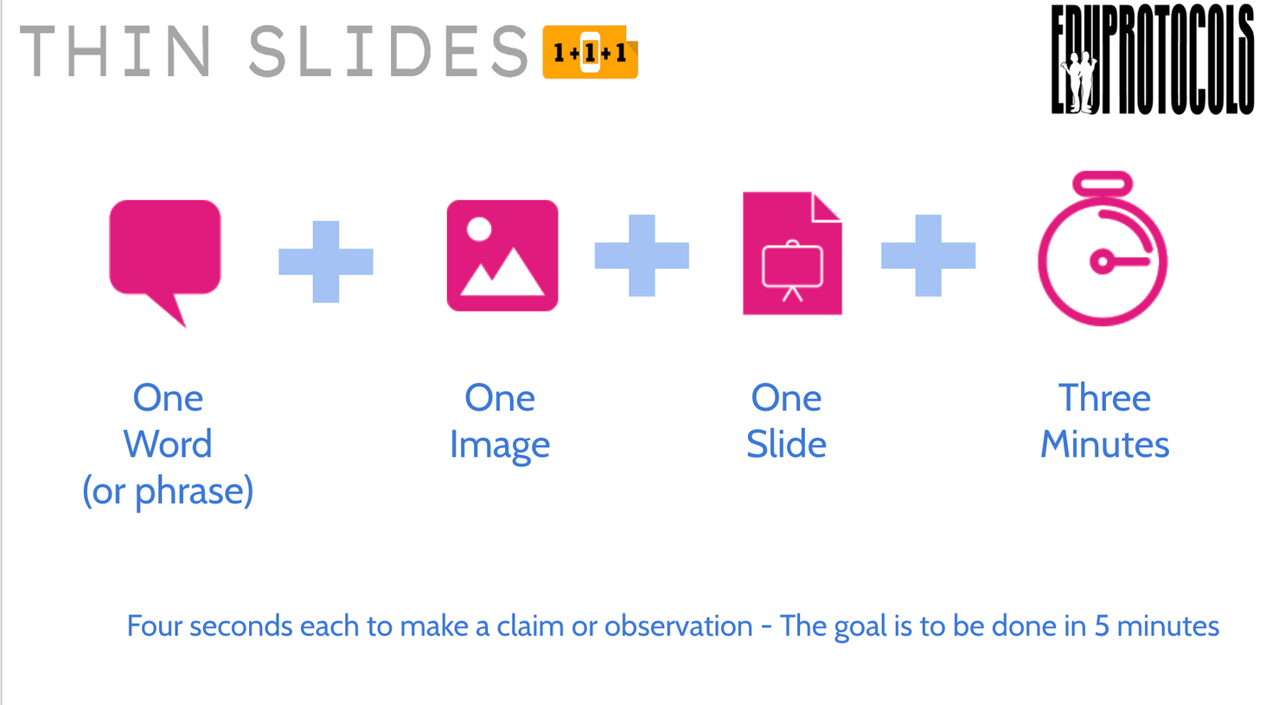
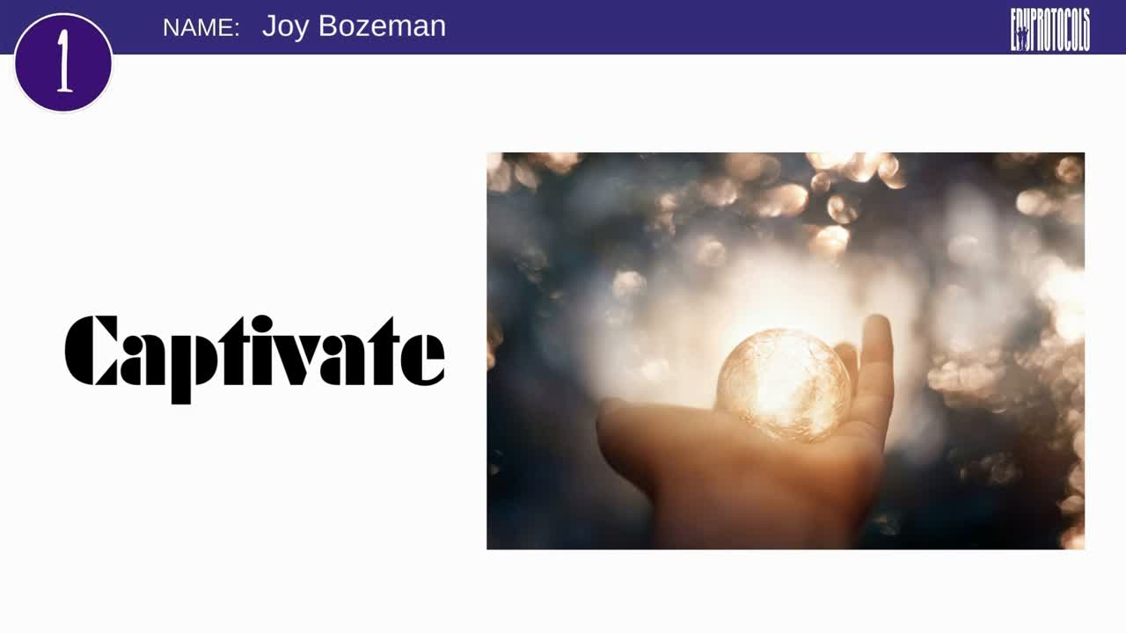

Slide 57

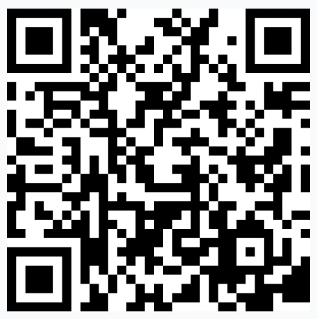

Slide 58
QUESTIONS
?

Slide 59
Tech Across the
Curriculum in HDFS
Dr. Celeste Hill

Slide 60
Tech Across the Curriculum in HDFS
Publisher learning platforms
Science-based influencers
Gaming
SPSS

Slide 61
AI in the Classroom
Using AI to identify bias in family policy news articles
1
Dialoging with AI
2
Quizzing with AI
3

Slide 62
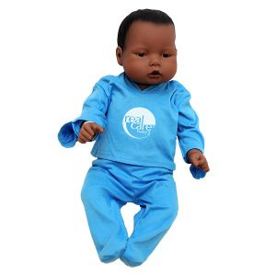
Infant Simulation
RealityWorks RealCare® Baby - 4 babies (Hispanic, African American, White, and Asian)
16-hour simulation, including overnight care
Student responsibilities: feeding, burping, diapering, and rocking
SIM measures: time in clothing, temperature regulation, neglect, abuse, time in car seat, head support, shaken baby, wrong position, and rough handling

Slide 63
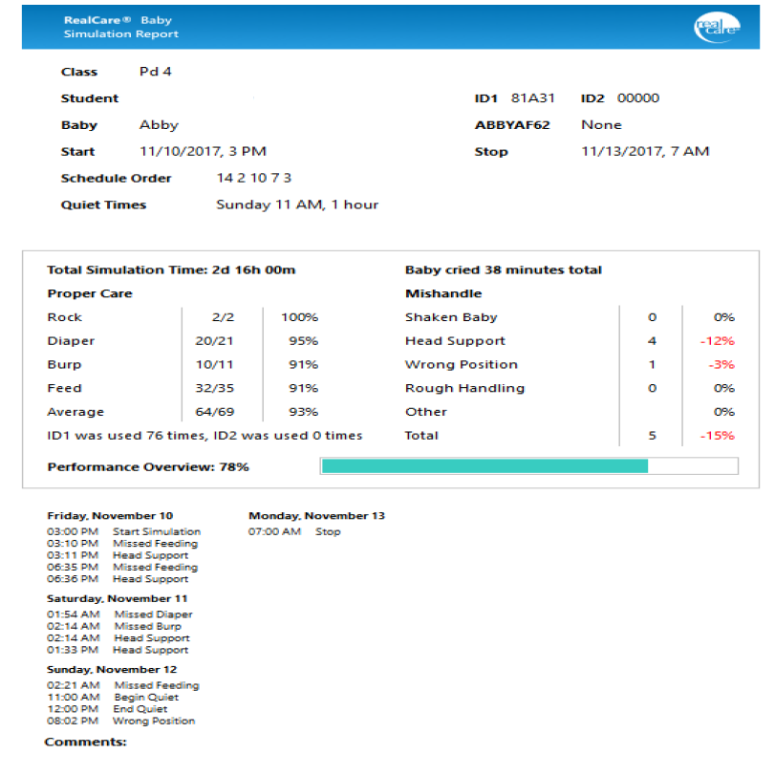
Sample Report

Slide 64

Key Reflection Themes
Parental Expectations and Social Judgment
Schedules and Sacrifices
Desire for Caregiver-Infant Interaction
Mental Toll and Coping Mechanisms

Slide 65
Introduction
to
ReciteWorks
Dr. Amy Benton

Slide 66
Introduction to ReciteWorks
ReciteWorks is a valuable online platform designed to assist students, researchers, and professionals in generating citations and references in APA format. It streamlines the reference management process, making it easier to create, organize, and format citations accurately.

Slide 67
Features of ReciteWorks
Automatic Citation Generation
Easily generate APA citations by entering the details of your source (e.g., author, title, date).
Supports various sources, including books, journal articles, websites, and more.
User-Friendly Interface
Intuitive design allows users to navigate the platform effortlessly.
Simple input forms make citation creation quick and straightforward.
Reference Management
Organize your citations in one place, making it easier to compile your reference list.
Edit and update existing citations as needed.
Formatting Assistance
Ensure proper APA formatting for in-text citations and reference lists.
Provides guidelines and examples to help users understand APA style.
Export Options
Export your citation lists in various formats (e.g., Word, PDF) for easy integration into your documents.

Slide 68
Benefits for APA Users
Time-Saving: Quickly generate citations without manually formatting.
Accuracy: Reduces the risk of errors in citation formatting.
Accessibility: Available online, making it easy to access from anywhere with an internet connection.
Learning Resource: Helps users learn and understand APA citation rules through practical examples.

Slide 69
So how does it work?
Welcome to Recite (1)

Slide 70
Conclusion
ReciteWorks is an essential tool for anyone working with APA citations. Its features enhance productivity and ensure adherence to APA standards, making it a must-have resource for students and professionals alike.

Slide 71
AI Translation Tools in
P-12 Environments
Dr. Jeanelle Day

Slide 72
AI Translation Tools in P-12 Environments
Purchase of 20 WT2/W3 Timekettle AI bi-directional translation earbud sets.
Used in Ecuador with SOE participants over Samford Spring Break.
Participants asked to fill out pre-trip and post-trip Intercultural Sensitivity Scale (survey) on Qualtrics (ISS; Chen & Starosta, 2000).

Slide 73
Preliminary Data
 | PreTest (n=3) | PostTest (n=4)
I enjoy interacting with people from different cultures. | 4.67 | 5
I think people from other cultures are narrow-minded. | 3 | 1.25
I am pretty sure of myself in interacting with people from different cultures. | 4 | 4.25
I find it very hard to talk in front of people from different cultures. | 2.67 | 1.5
I always know what to say when interacting with people from different cultures. | 3.33 | 3.25
I can be as sociable as I want to be when interacting with people from different cultures. | 4.67 | 4.25
I don't like to be with people from different cultures. | 2.33 | 1
I get upset easily when interacting with people from different cultures. | 2.33 | 1
I feel confident when interacting with people from different cultures. | 3.67 | 4
I tend to wait before forming an impression of culturally-distinct counterparts. | 4.33 | 3.5
I often get discouraged when I am with people from different cultures. | 2.33 | 1.5

Slide 74
Preliminary Data Continued
I am open-minded to people from different cultures. | 4.67 | 5
I am very observant when interacting with people from different cultures. | 4.67 | 5
I often feel useless when interacting with people from different cultures. | 2.67 | 2.25
I respect the ways people from different cultures behave. | 4.67 | 5
I try to obtain as much information as I can when interacting with people from different cultures. | 4.67 | 5
I would not accept the opinions of people from different cultures. | 2.67 | 1
I am sensitive to my culturally-distinct counterpart's subtle meanings during our interaction. | 4 | 3.75
I think my culture is better than other cultures. | 4 | 1.5
I often give positive responses to my culturally different counterpart during our interaction. | 3.67 | 4.5
I avoid those situations where I will have to deal with culturally-distinct persons. | 2.67 | 2
I often show my culturally-distinct counterpart my understanding through verbal or non-verbal cues. | 4 | 4.5
I have a feeling of enjoyment towards differences between my culturally-distinct counterpart and me. | 4.33 | 4.25

Slide 75
Assistive Technology:
Making Learning Accessible
for All Students
Dr. Mandy Hilsmier
and
Dr. Kayla Wenth

Slide 76
Hilsmier & Wenth
Assistive Technology
Two-Fold Purpose:
to provide assistive technology devices that would benefit Samford students receiving services from the office of accessibility and accommodations
to provide prospective teachers in the ESEC program, Elementary Missions, SEED, HDFS, and Educational Leadership programs training and experiential learning so that they can understand how to use assistive technology to open doors for the students with disabilities with whom they work.

Slide 77
Hilsmier & Wenth
iPads- 64 mb
Gazepoint SD Eye Tracker Bundle
Caption Companion
AbleNet Kinderboard and BigTrack 2 Combo
GoTalk 9 with Go Talk Design
Amazon Echo Show 9
Soundnote App
Avac AAC- Lifetime Edition
Sentence Builder App
Flip Writer App
Assistive
Technology
Devices
Available for
Checkout

Slide 78


