Slide 1

Big Questions in
Science and Religion
Samford University
Center for Science and Religion

Slide 2
Relationships between Science and Religion
Big Questions in Science and Religion
Samford University Center for Science and Religion

Slide 3

What is Science?
The word scientia originally meant general knowledge and was inferior to sapientia which meant wisdom
Science as an occupation did not appear until the 19th century
Before the 19th century, many scientists sought to provide evidence for religion (natural philosophy)
Image source: http://publishingarchaeology.blogspot.com/2012/01/rejected-by-science_27.html (fair use)

Slide 4

A Definition of Science
Acquisition of reliable but not infallible knowledge of the real world, including explanations of the phenomena
  Science is a process, not a body of knowledge
  Science is always tentative (what hasn’t been disproved)
  Science deals with empirical knowledge
  Science includes explanations in the form of hypotheses, theories, and laws
Image source: http://www.amazon.com/Scientific-Endeavor-Primer-Principles-Practice/dp/0805345965/ref=sr_1_1?s=books&ie=UTF8&qid=1358951332&sr=1-1&keywords=scientific+endeavor (fair use)

Slide 5

What is Religion?
The word religio initially meant an inner piety or desire to lead a Christ-like life
Religion as a body of beliefs and practices appeared around the 17th century, partially as a result of the Protestant Reformation
Image source: http://www.eurasiareview.com/25022011-religion-and-terrorism-a-socio-historical-reconsideration/ (fair use)

Slide 6
A Definition of Religion
A strong belief in a supernatural power or powers that control human destiny
An institution to express belief in a divine power
A belief concerning the supernatural, sacred, or divine, and the practices and institutions associated with such belief
The sum total of answers given to explain humankind’s relationship with the universe

Slide 7
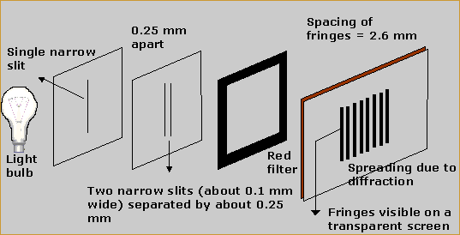
How Do We Know Things in Science?
Experiments seek to control all (or almost all) variables associated with a phenomenon
Observation of phenomena that can’t be controlled (paleontology, cosmology, ethology) together with reason
Evidence is reported in peer-reviewed journals available to all
Best explanations are predictive
Image source: http://www.tutorvista.com/content/physics/physics-iv/optics/interference-light.php (fair use)

Slide 8
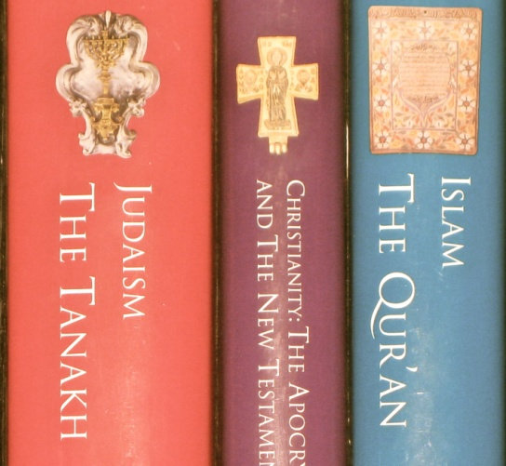
How Do We Know Things in Religion?
Sacred texts are inspired by divine power
Individual revelation through visions, dreams, prayer, events
Reason about the nature of God and the relationship between God and humans
Study of sacred texts and the conditions under which they were written
Study of the natural world?
Image source: http://news.gts.edu/2012/05/deirdre-good-joins-interfaith-presentation-on-sacred-texts/sacred-texts/ (fair use)

Slide 9

Worldviews
We all have belief systems that influence how we answer the important questions of life
  Range of views within Christianity, Judaism, agnosticism, relativism, Buddhism, atheism, Islam
  Scientists also have worldviews (paradigms) that determine the questions they investigate
  Are there differences in worldviews between science and religion?
Image source: http://www.eurasiareview.com/25022011-religion-and-terrorism-a-socio-historical-reconsideration/ (fair use)

Slide 10
Scientific and Christian Beliefs
Beliefs Needed for Science
Christian Beliefs
Nature can be studied by humans
Nature works by natural cause and effect
Natural phenomena are repeatable/observable
Experiments and observations are needed for explanation
Source: Haarsma and Haarsma, Origin: A Reformed Look at Creation, Design, and Evolution (Grand Rapids, MI: Faith Alive, 2007)
Humans are made in the image of God
God rules the world in a faithful, consistent manner
God has established natural laws
Humans are not able to understand God’s world completely

Slide 11
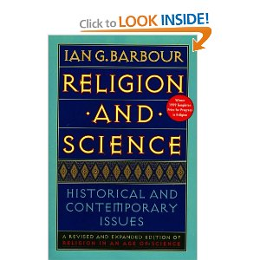
How Do Science and Religion Relate to Each Other?
Ian Barbour identified four ways
  Conflict
  Independence
  Dialogue
  Integration
  From Barbour, Religion and Science: Historical and Contemporary Issues (New York: HarperCollins, 1997)
Image source: http://www.amazon.com/Religion-Science-Gifford-Lectures-Barbour/dp/0060609389/ref=sr_1_1?s=books&ie=UTF8&qid=1358952534&sr=1-1&keywords=religion+and+science+ian+barbour (fair use)

Slide 12

Conflict
Religion and science are two ways of viewing the same things; therefore one is correct and the other is incorrect
Both are based on interpretation of the Bible
  Scripture is inerrant in everything it comments on and if science appears to contradict the Bible, science is wrong (Biblical literalism or inerrancy)
  Parts of the Bible are contradicted by science, so all of the Bible must be rejected and therefore science is the only reliable path to knowledge of the real world (scientism, philosophical materialism)
Image source: http://www.conflictdynamics.org/blog/tag/office-conflict/
(used with permission)

Slide 13

Conflict
Scientific Materialism
  Scientific method is the only reliable path to knowledge
  Matter (or matter and energy) is the fundamental reality in the universe
  Science can be reduced to chemistry and physics
Image source: http://www.boston.com/jobs/galleries/workplaceconflict/ (fair use)

Slide 14
Conflict
In order to accept this model, scientific materialists must believe that:
  they are completely neutral with respect to their biases and worldviews
  all of life, including the arts, social sciences, and others, is reducible to physical processes
  that there is a single way of interpretation of the Bible, and that it is mistaken
  Are these true?

Slide 15
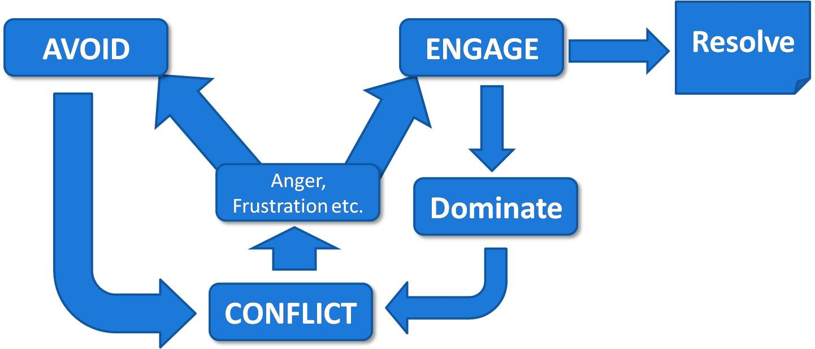
Conflict
Biblical Literalism
  Scripture is inerrant in everything it comments on
  If science appears to contradict the Bible, science is wrong
Image source: http://www.maximumadvantage.com/conflict-resolution-in-the-workplace.html (fair use)

Slide 16

Conflict
In order to accept this model, Christians must believe that:
  there are no conflicts, inaccuracies, or contradictions in the Bible
  scientists are mistaken or purposely fraudulent in their investigations into origins (and origins alone; i.e., not with respect to medicine, technology et al.)
  scientists are hostile to Christianity (or religion)
  Are these true?
Image source: http://heatherdhawkins.blogspot.com/2009/05/clergy-letter.html (fair use)

Slide 17

Independence
Contrasting Methods
  Science and religion are separate spheres of human life
  Religious faith depends on divine initiative, science relies on human discovery
  Science is thought to be testable, public, and objective while religion is not testable, private, and subjective
Image source: http://www.bethinking.org/science-christianity/ways-of-understanding-science-and-religion.htm (fair use)

Slide 18
Independence
Differing Languages
  Scientific language is used primarily for prediction and control (theories, delimited questions)
  Religious language elicits a set of attitudes and encourages allegiance to moral principles
  Religious language often deals with liberation from suffering and experiences of peace and unity (not scientific)
What it means: science will discover/explain everything it can, and religion will explain the rest

Slide 19
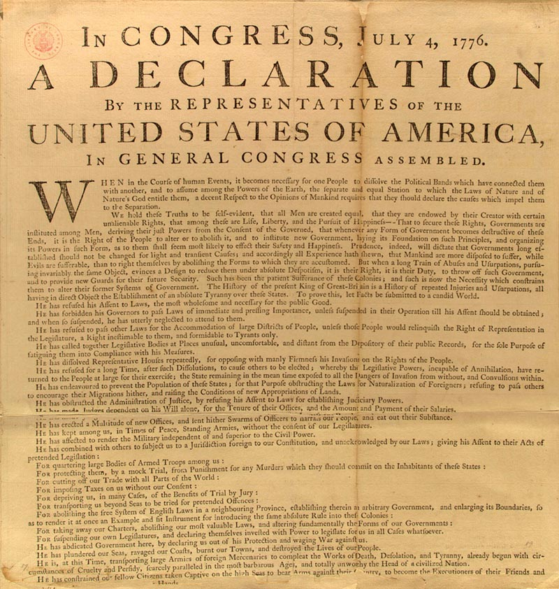
Independence
Problems with this model: people generally like to be consistent in their beliefs
For Christians, God is sovereign over everything, not just the non-scientific part of life
Where should evolution be placed?
Image source: http://www.loc.gov/exhibits/treasures/trt024.html (fair use)

Slide 20
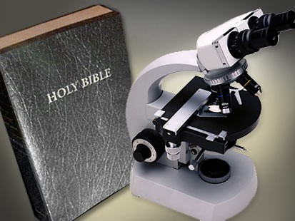
Independence
Does Scripture influence interpretation of science?
  May be a misuse to read into the Bible things it may not intend to teach (farming, economics, weather, e.g.)
  The Bible tells us to look beyond science for explanations
Does science influence interpretation of Scripture?
  May be a misuse to ignore parts of Bible that conflict with science
  Scientific findings can change and improve understanding of Scripture
Image source: http://defendchristianfaith.blogspot.com/2012/04/science-and-religion-do-mix.html (fair use)

Slide 21

Dialogue
Methodological parallels
Religion and science are alike in certain ways: religion is not necessarily completely subjective and science is not necessarily completely objective
Scientists are not just passive observers (quantum mechanics)
If God created the world and humans, God meant for humans to know the world
Image source: http://en.wikipedia.org/wiki/Dialogue (fair use)

Slide 22
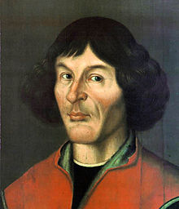
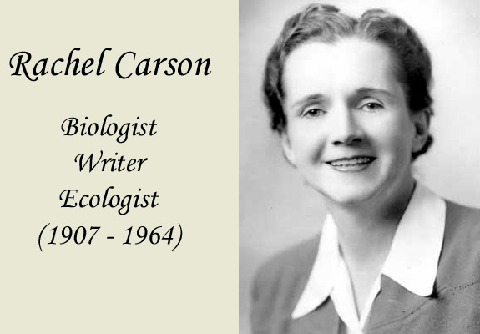
Dialogue
Nature-centered spirituality
  Some scientists have had spiritual experiences in the study of nature (Copernicus, Rachel Carson)
Image source: http://ircamera.as.arizona.edu/NatSci102/NatSci102/lectures/copernicus.htm (fair use)
Image source: http://www.rachelcarson.org/ (fair use)

Slide 23
Dialogue
Intelligibility and contingency can be areas of dialogue: neither is completely answerable by scientific methods
God is the primary cause and works through secondary causes, which science can describe
  Avoids God of the gaps, since science is complete on its own
In order to accept this model, Christians and scientific materialists must be open to the other’s viewpoint

Slide 24
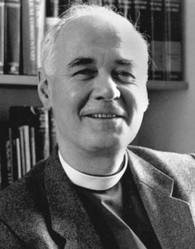
Integration
Natural theology
  Existence of God can be inferred from design in nature, which science has helped us see
  God can be viewed as the Designer of a self-organizing system
Theology of nature
  Main sources of theology are outside science, but scientific theories may affect the reformulation of certain doctrines, particularly creation and human nature
  “new natural theology” doesn’t offer arguments for the existence of God but focuses on features of the universe as a whole (Polkinghorne)
  Example: fine tuning of the universe is luck, multiple universes, or creation with conditions for evolution
Image source: http://incharacter.org/features/john-polkinghornes-unseen-realities/ (fair use)

Slide 25

Integration
Systematic synthesis
  Science and religion both contribute to an inclusive metaphysics, such as in process philosophy
  Potential problem with the type of God nature implies (deist vs. personal)
Image source: http://evolve4peace.com/2012/10/02/science-and-religion/ (fair use)

Slide 26
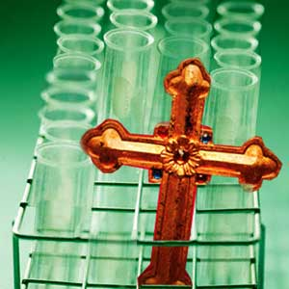
Integration
In order to accept this model, science and religion must be of equal (or nearly equal) importance
In order to accept this model, both Christians and scientists must be willing to modify some of their views in light of new evidence and thinking
Image source: http://whatafy.com/science-and-religion-sworn-enemies.html (fair use)

Slide 27
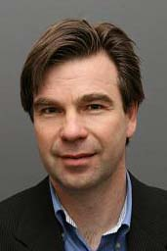

Other views of the relationship between science and religion
Image source: http://www.crs.uu.se/Research/impactofreligion/Theme_6/Customized+Science+I%3A+Value-Free+versus+Value-Directed+Science/?languageId=1
Photo credit Max Marcus, Uppsala University
Used with permission
Mikael Stenmark
  Relationship between science and religion is dynamic, so discrete borders are hard to draw
Nancey Murphy
  Five-fold typology related to Niebuhr’s interactions between religion and culture
  States that theology can influence science
Photo credit Max Marcus, Uppsala University
Used with permission
Image source: http://www.iscast.org/event_2011_08_19_Annual_Lecture_Vic
Notes:
Nancey Murphy, "A Niebuhrian Typology for the Relation of Theology to Science," Pacific Theological Review XVIII, Three (Spring 1985): 16-23.
Stenmark, Mikael, “Ways of relating science and religion”, Cambridge Companion to Science and Religion, 2010: 278-295.

Slide 28
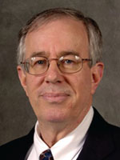
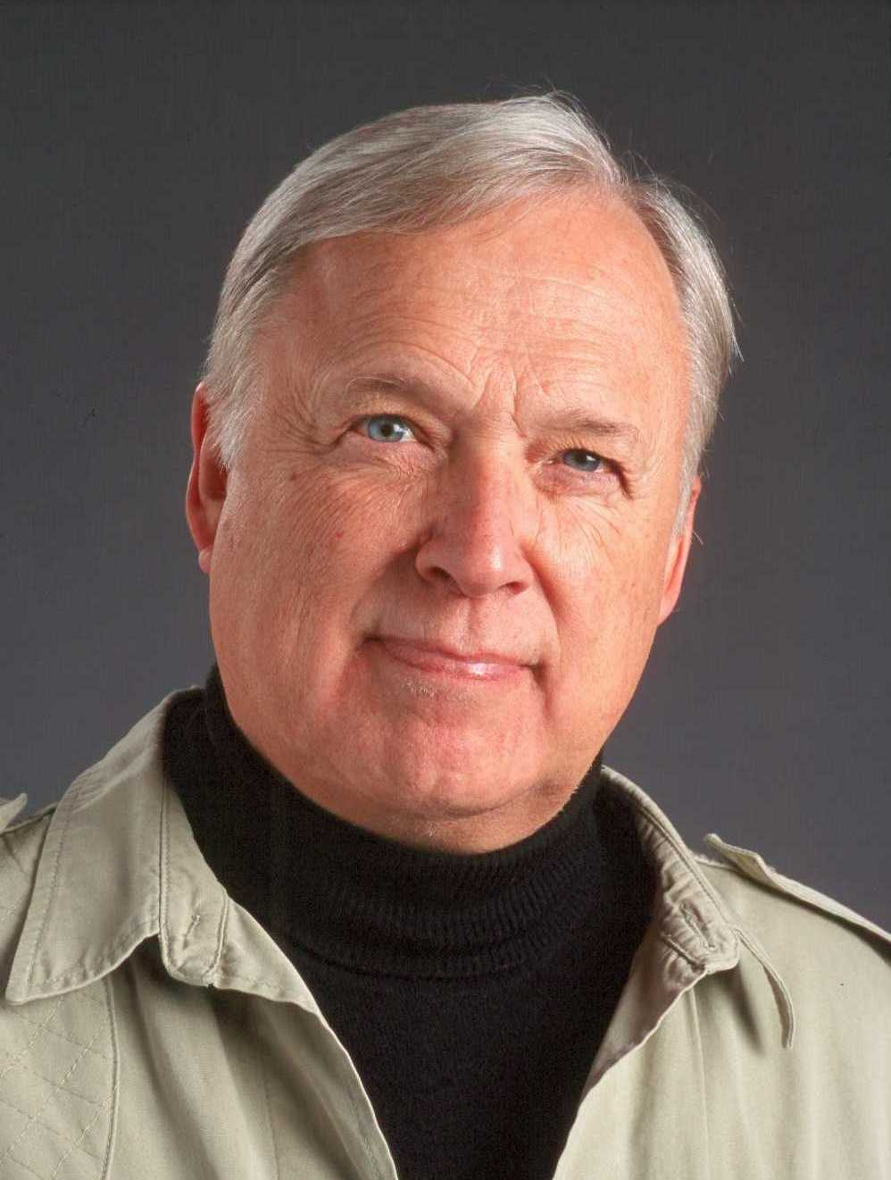
Other views of the relationship between science and religion
John Haught
  Conflict, contrast, contact, and confirmation
  Confirmation tells of theology’s effects on philosophical assumptions of science
Ted Peters
  Eight-fold typology emphasizing history, ethics, and New Age spirituality
  Claims that only science can produce new knowledge
Image source: http://polyskeptic.com/tag/john-haught/ (fair use)
Image source: http://spacetheology.blogspot.com/2012/04/professor-ted-peters.html (fair use)
Notes:
John F. Haught, Science & Religion: From Conflict to Conversion (New York: Paulist Press, 1995), Ch. 1.
Ted Peters, Ed., Science & Theology: The New Consonance (Boulder, Colorado: Westview Press, 1998), p. 13-22.

Slide 29
How Do We Evaluate Claims Made by Religion and Science?
Critical thinking helps us determine the which claims are more likely to be true
Being aware of our own thinking (and our own biases, cultural values, etc.) can help us evaluate claims also
Looking for the strengths and weaknesses of others’ arguments and our own can help us determine the truth of conflicting claims
Examples of weaknesses in claims?

Slide 30
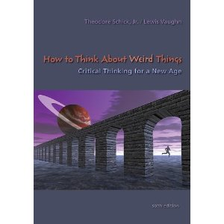
Fallacies Associated with Religion and Science
Begging the question: the conclusion is used as one of the premises (circular reasoning)
False dilemma: presumes only two alternatives exist when there may be more than two
  From Schick and Vaughn, How to Think About Weird Things: Critical Thinking for a New Age, (New York: McGraw-Hill, 2011)
Image source: http://www.amazon.com/How-Think-About-Weird-
Things/dp/007353577X/ref=sr_1_1?s=books&ie=UTF8&qid=1358953931&sr=1-1&keywords=schick+and+vaughn (fair use)
Notes:
Example of begging the question: Is the Bible true? It says it is, therefore it must be true. The conclusion (the Bible is true) is used as one of the premises (the Bible says it’s true).
Example of false dilemma: either biblical creation is true or evolution is true. This argument ignores other versions of creation as well as nuanced views of creation and evolution such as theological evolution.

Slide 31
Fallacies Associated with Religion and Science
Appeal to authority: the use of experts’ opinions in a field in which they are not experts
Appeal to the masses: argument must be true if a large number of people believe it to be true
Notes:
Example of appeal to authority: Richard Dawkins makes philosophical claims about Christianity though he is neither a theologian or a philosopher. Many persons of faith make claims about aspects of science they themselves have never studied. Note that neither example means the persons are wrong, simply that they are speaking about subjects as laypeople rather than as experts.
Example of appeal to the masses: surveys show that a majority of Americans believe in a biblical view of creation, therefore that must be correct. Surveys of Europeans in the Middle Ages would have shown an almost 100% agreement that the sun revolves around the earth.

Slide 32
Fallacies Associated with Religion and Science
Appeal to tradition: argument that something must be true because it’s part of an established tradition
Appeal to ignorance: opponents’ inability to disprove a conclusion is proof of its incorrectness
Appeal to fear: use of harm to advance one’s position
Straw man: misrepresenting someone’s claim to make it easier to dismiss or reject
Notes:
Example of appeal to tradition: “we’ve always felt that way”.
Example of appeal to ignorance: if they can’t show how something happened, then it didn’t happen that way. The usual counter to this argument is that absence of evidence is not evidence of absence.
Example of appeal to fear: often Hitler/Nazism is used to scare people into believing a position, such as “Hitler used Darwinism to promote eugenics” or “Hitler was a Christian.”
Example of a straw man argument: since no one has seen a cat give birth to a rabbit, evolution cannot be true. Evolution has never made such a claim, so the argument is a straw man.

Slide 33
Fallacies Associated with Religion and Science
Faulty analogy: using analogy without looking at dissimilarities
Slippery slope: performing one action necessarily leads to additional bad actions

Slide 34
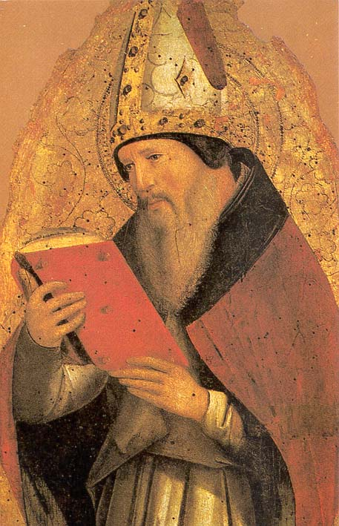
From St. Augustine. . .
Image source: http://gavinortlund.wordpress.com/2012/04/18/augustines-intellectual-development/ (fair use)
“If [people outside the faith] find a Christian mistaken in a field which they themselves know well and hear him maintaining his foolish opinions about our books, how are they going to believe those goods and matters concerning the resurrection of the dead, the hope of eternal life, and the kingdom of heaven, when they think their pages are full of falsehoods on facts which they themselves have learned from experience in the light of reason?”

Slide 35
Conclusion
In thinking critically about Christianity and evolution we need to:
  realize that there are more than two positions
  carefully consider claims, whether they agree with our position or not
  consider whether biases are affecting a claim, either our own biases or those of another

Slide 36
Conclusion
In thinking critically about Christianity and evolution we need to:
  use reason as well as emotion in evaluating claims
  trust (at least provisionally) the opinions of experts, but only in their areas of expertise
  have the humility to admit that we may be wrong (after all, there are a variety of views already)

Slide 37
Questions
Which of the ways of knowing are you most comfortable with?
The media tend to emphasize the conflict model. Why do you think this is so? Is this the most common model?
What is the role of reason in religion? In what ways does science seem like a religion?

Slide 38
Relationships Between Science and Religion
George E. Keller III, Ph.D.
Samford University
Conditions of Use
The slides contained in this presentation and the accompanying notes are freely available for use and/or modification by individuals and groups to promote understanding and dialogue in science and religion with the stipulation that they may not be sold or traded individually, collectively, or otherwise for any form of financial or material gain. The source of all images in this collection of slides is either noted directly (if required by the author) or may be viewed by clicking an image (in edit mode) and then clicking “Send to Back.” These forms of crediting images must be included in any use or derivation of these materials.
The contents of these slides and the accompanying notes reflect the views of the author and should not be assumed to represent the position of Samford University or its employees.

