Slide 1

Big Questions in
Science and Religion
Samford University
Center for Science and Religion

Slide 2
Where did we come from?
Big Questions in Science and Religion
Samford University Center for Science and Religion

Slide 3

Relation of Science and Religion
Generally thought to be locked in conflict
Can you be a Christian and a scientist?
Can you be a scientist and be a Christian?
http://sciencebasedlife.files.wordpress.com/2011/09/religion-vs-science.jpg (fair use)

Slide 4
Johns Hopkins celebration of the Twenty-fifth Anniversary of the Founding, (Baltimore 1903) pp. 15-16
“Science is recognized as the handmaid of religion. Evolution is regarded by many theologians as confirming the strictest doctrines of predestination. The propositions which were so objectionable thirty years ago are now received with as little alarm as the propositions of Euclid. There are mathematicians who do not regard the Euclidean geometry as the best mode of presenting certain mathematical truths, and there are also naturalists who will not accept the doctrines of Darwin, without limitations or modification, but nobody thinks of fighting over the utterances of either.”
How times have changed!!

Slide 5
Discussions tend to two forms
Persuasion by Intimidation
Persuasion by Ridicule
This lecture will reject both

Slide 6
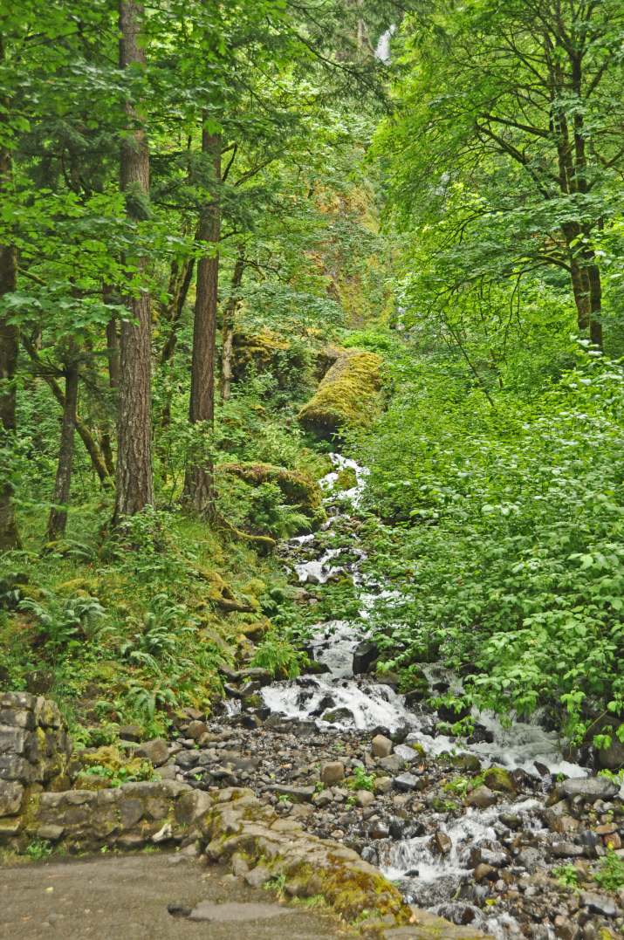

Faith and Science are God’s two paths to give us Knowledge.
Photo courtesy of Wilton Bunch
Photo courtesy of Wilton Bunch

Slide 7

Science
In Science, Nature is explored through the use of strict demonstration, involving experimentation and repeatability. Once a scientific possibility is show to be the case, the honest person must assent to it.
Public Domain Image: http://openclipart.org/detail/47179/stylized-atom-2-by-j_alves

Slide 8

Faith
Knowing a spiritual reality involves a constant openness to know and an openness to be known. The will is not forced, as it is in science. In faith, thinking and assent walk hand-in-hand in an act of trust.
Public Domain Image: http://openclipart.org/detail/472/adult-and-child-by-liftarn

Slide 9
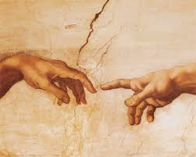
God reaches down, humans reach up.
The Bible tells two histories at the same time.
We have the history of God reaching down
with His grace and saving love. In this
regard, Scripture is inerrant.
The Bible tells the history of people reaching
up to God. In this, God’s truth is told in their
history, their level of learning, and the
conditions of their time and culture.
Public Domain Image
We must be careful not to confuse the two ways the Bible speaks.

Slide 10
Divine Message of our origins
1. Universe created by a God who is intelligent and perfectly good.
2. Creation came about by speaking, not a divine brawl, and had a definite beginning.
3. Sun, moon and stars were created, are not divine.
4. The world is good, a reflection of its creator.

Slide 11
Where did we come from?
We can consider change two ways:
  Cosmology
        (Beginnings of Universe)
  Evolution
            (Beginnings of Life on Earth)

Slide 12
Cosmology
The scientific description of the origin and change of the universe is Cosmology.
Cosmology consists of two parts
  Big Bang and formation of material
  Continued expansion of the universe

Slide 13
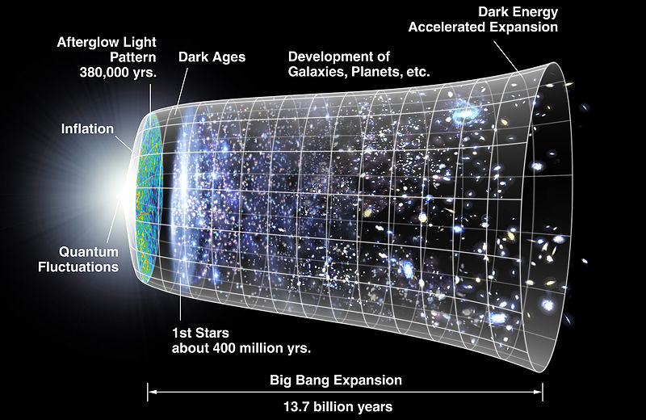
Big Bang
10⁻³⁷ sec. Elementary particles
10 ⁻⁶ sec. Protons and neutrons
379,000 years. Hydrogen and Helium
      Temperature 1 billion degrees Kelvin
Public Domain Image: http://en.wikipedia.org/wiki/File:CMB_Timeline300_no_WMAP.jpg

Slide 14
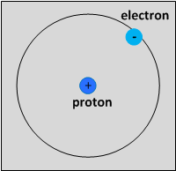
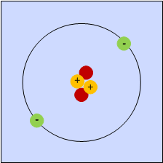
Big Bang
“Long Time” Gas Clouds
90 Million Yrs. Stars
Fusion of light elements produces energy
Fusion Hydrogen → Helium;
Image courtesy of Samford University Center for Science and Religion
Image courtesy of Samford University Center for Science and Religion

Slide 15
Big Bang
Production of heavy elements requires energy
  Gravity causes clumping of H and He → stars
  Core of stars change from H → He →Carbon
    Becomes much hotter
  Neutrons extruded from core and captured by elements which gain one atomic number for each neutron

Slide 16
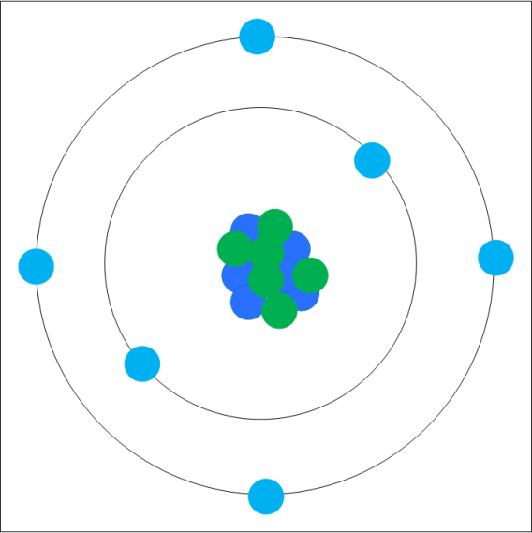
Formation of the carbon atomic nucleus requires a nearly simultaneous triple collision of alpha particles (helium nuclei) within the core of a giant or supergiant star
              →
Image courtesy of Samford University Center for Science and Religion
Image courtesy of Samford University Center for Science and Religion

Slide 17
Where do we get the Idea of the Big Bang?
1914 V.M. Slipher: Studied 25 galaxies moving away
1925 Added 20 more-suggested was true of all galaxies
1929 Hubble and Humanson: 100” telescope
Galaxies were much further away than suspected
Millions of light years away
Galaxies were moving away at very rapid speeds
Further away, the faster they were moving away
Observations, but no explanations.

Slide 18
Georges Lemaitre 1927
Solved Einstein’s equations of general relativity show an enlarging universe.
  Contrary to what Einstein believed
Suggested the universe must have originally be concentrated in an incredibly dense “atomic atom” that exploded to produce the universe we see.

Slide 19

Balloon image source: http://openclipart.org/detail/74221/balloon-by-jgm104 (public domain image) - Modified image courtesy of Samford University Center for Science and Religion
Balloon illustration: Dots represent galaxies and balloon expansion represents expanding universe

Slide 20
This idea was rejected by many scientists.
de Sitter: “One cannot take these predictions seriously.”
Eddington: “The notion of a beginning that started with a bang . . . leaves me cold.”
Nernst: “To deny the infinite duration of time would betray the foundations of science.”
1960: 2/3 of American astronomers believed the universe had no beginning.
It looked too much like religion!!

Slide 21
There are certain parallels between science descriptions and Genesis.
Big Bang Theory
  Light existed from the beginning
  Stars developed much, much later
  We can’t expect this parallelism for everything.

Slide 22
Present Idea
The early universe was filled with intense radiation.
As it cooled the radiation shifted to longer and longer waves.
1965 Penzias and Wilson (Bell Labs) discovered the residual of this radiation – the whisper of the big bang.
Other confirming evidence has convinced nearly all scientists the story is correct.

Slide 23
What about evolution?

Slide 24
Position of Catholic Church
Development was under guidance of God
  Ultimate creation must be ascribed to him.
The human body may have been specially created or developed.
Human soul is specially created and did not evolve.
Atheistic evolution is not permitted.

Slide 25
Position of Catholic Church
Genesis 1 may be history or a non-chronological topical reading.
However, Genesis 1 records God’s work.
It is impermissible to dismiss Adam and Eve and fall.
  It may be figurative language, but it affirms a primeval event that really took place.

Slide 26
Position of Evangelicals
“If you do not believe Genesis 1,2 literally you have no basis for believing in Jesus Christ.” Baptist Today, 2007
“Young Earth” Creationists

Slide 27
. . . But what is meant by “literally”
The Hebrew language is underspecified compared to English. There are many translations of the word most Bibles show as “day.” But it is equally literal to read it “year,” “eon” or even “a very long time”
What most people mean by “literally” is using the English word in “my” Bible exactly as it is used today and reading it back into history.

Slide 28
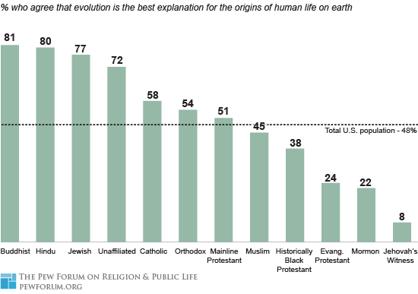
Source: http://www.pewforum.org/Science-and-Bioethics/Religious-Differences-on-the-Question-of-Evolution.aspx (fair use)
Source: http://www.pewforum.org/Science-and-Bioethics/Religious-Differences-on-the-Question-of-Evolution.aspx

Slide 29
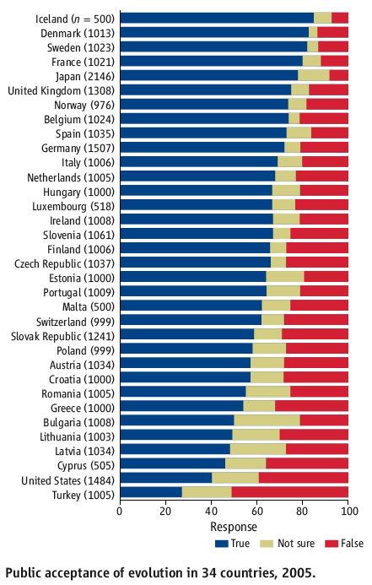
Source: Science 11 August 2006, Volume 313, pp. 765-766. Jon Miller, Eugenie Scott, Shinji Okamoto (fair use)
Source: Science 11 August 2006, Volume 313, pp. 765-766. Jon Miller, Eugenie Scott, Shinji Okamoto

Slide 30
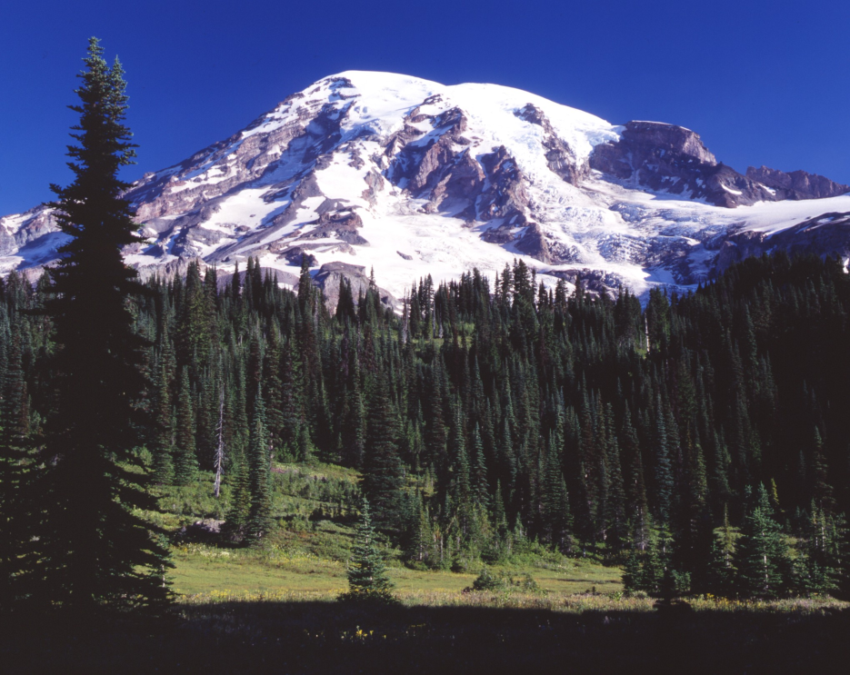
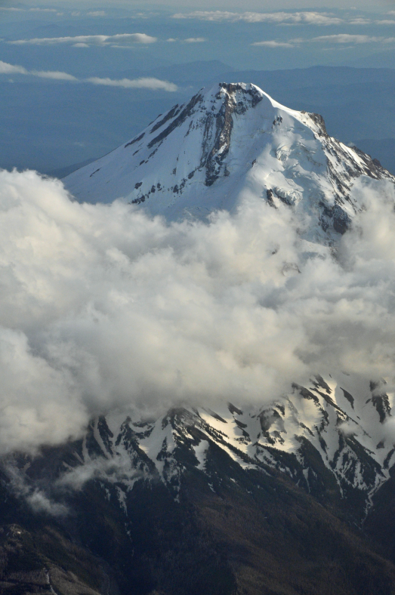
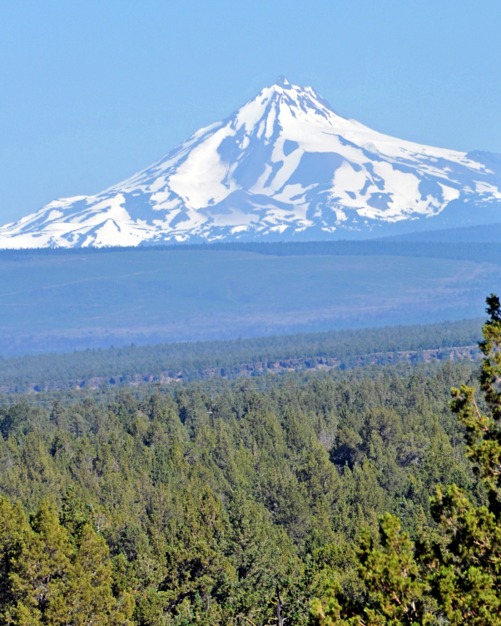
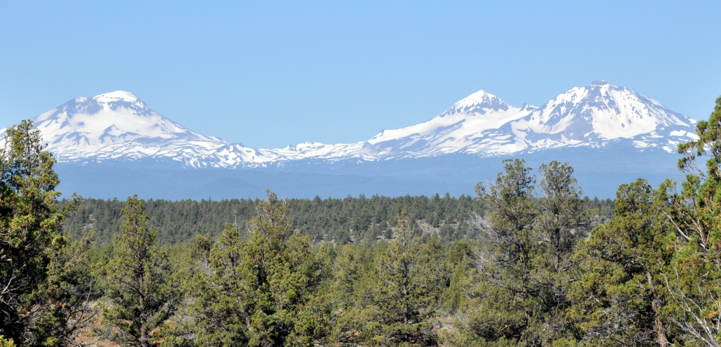
Changes
over Time
Photo courtesy of Wilton Bunch
Photo courtesy of Wilton Bunch
Photo courtesy of Wilton Bunch
Photo courtesy of Wilton Bunch

Slide 31
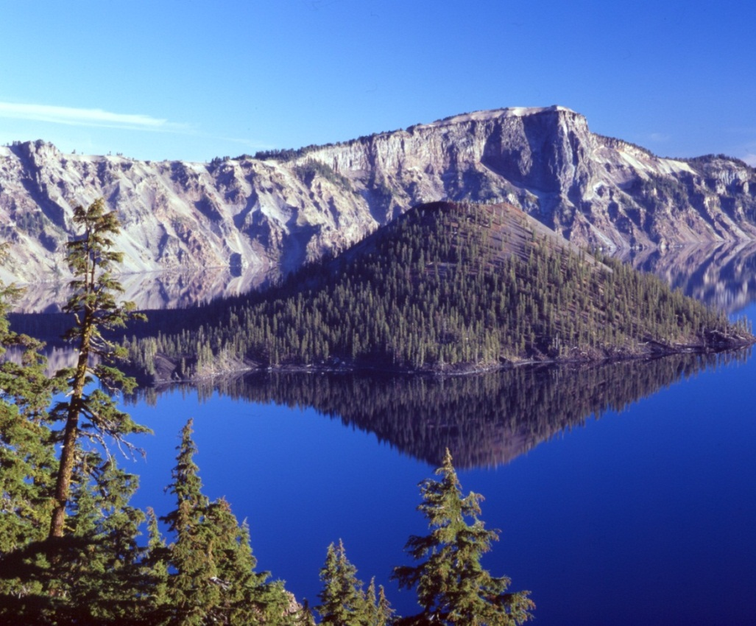
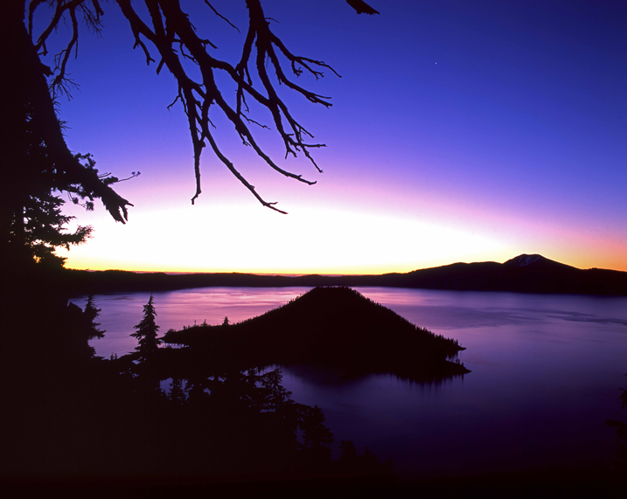
We have constant change, we just don’t recognize it.
Photo courtesy of Wilton Bunch
Photo courtesy of Wilton Bunch

Slide 32
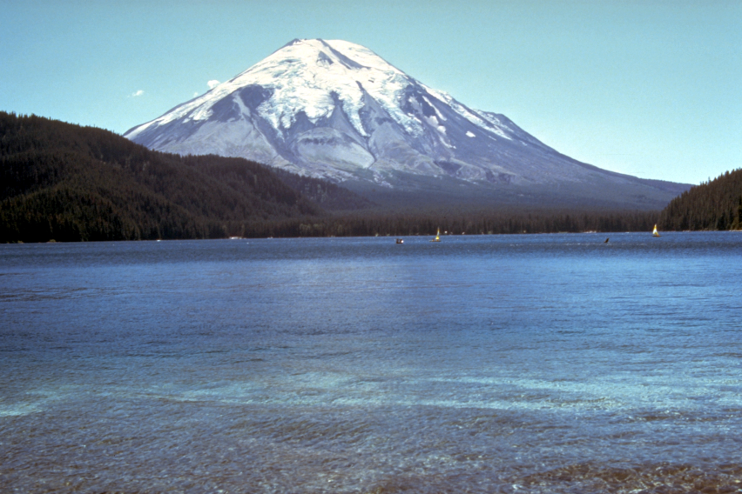
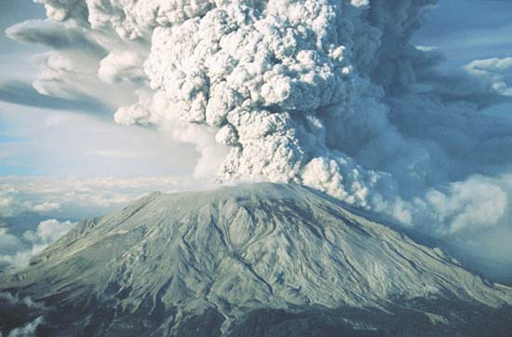
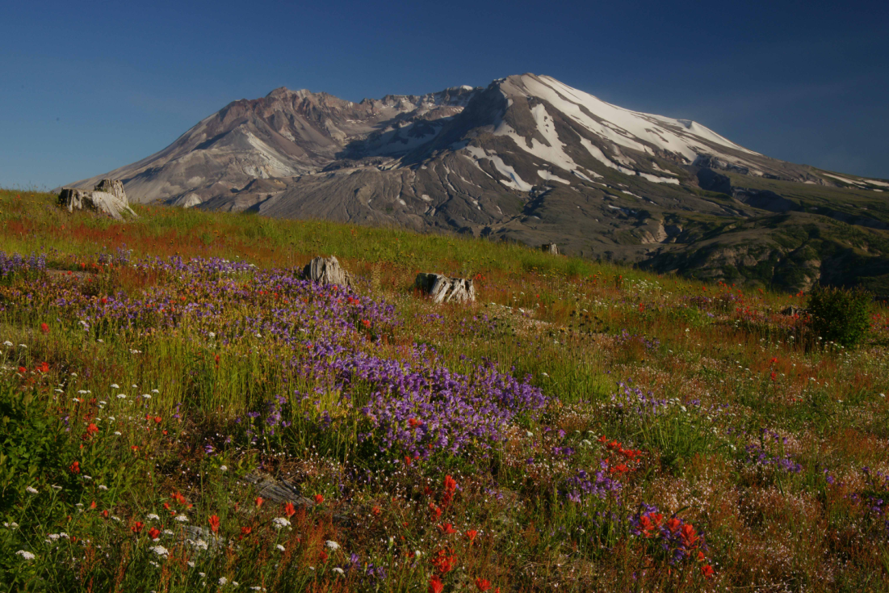
→
Photo courtesy of Wilton Bunch
Photo by George Bear, used with permission
→
Photo courtesy of Wilton Bunch

Slide 33
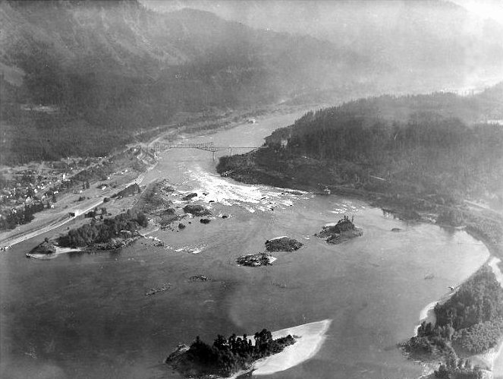
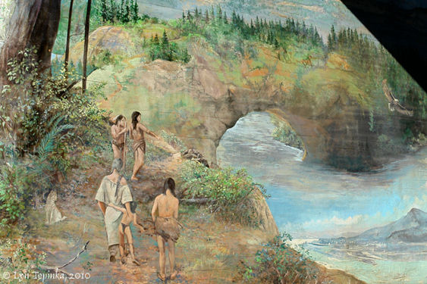
→
Public Domain Image: http://commons.wikimedia.org/wiki/File:Cascade_Locks_and_Falls.jpg
Photo by Wilton Bunch of mural at Bridge of the Gods Museum, Cascade Locks, OR

Slide 34
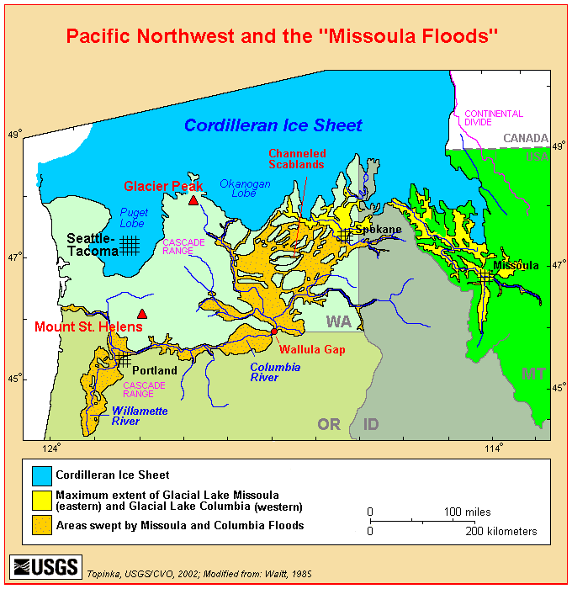
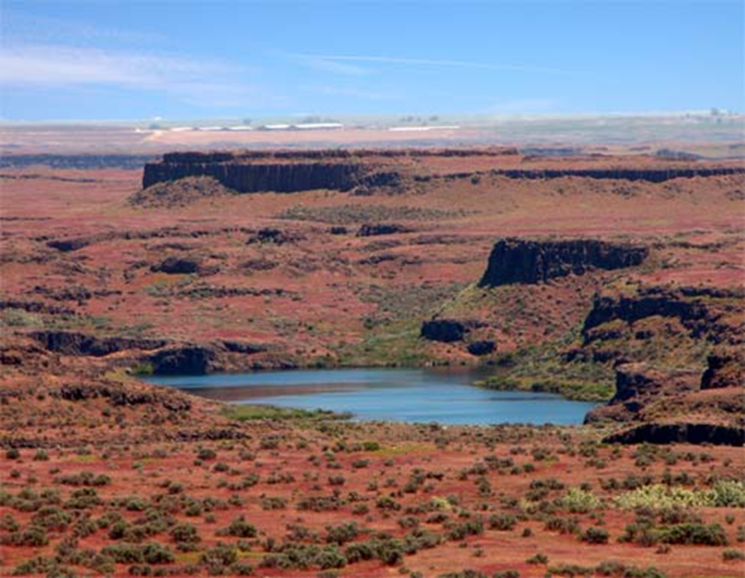
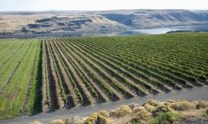
Change due to
Water
Public Domain Image: http://vulcan.wr.usgs.gov/Volcanoes/ColumbiaPlateau/summary_columbia_plateau.html
Photo courtesy of Wilton Bunch
Photo courtesy of Wilton Bunch
→

Slide 35
Constant Change
If something as solid as the crust of the earth can change so dramatically, why should we be surprised that things as fragile as plants and animals also change?

Slide 36
From (at least) late 4th century to early 21st century theologians have answered that question:
We should not be amazed by change nor impeded in our study of what God has given us.

Slide 37
St. Augustine on Creation
Usually, even a non-Christian knows something about the earth, and this knowledge he holds to as being certain from reason and experience. . . Now, it is a disgraceful and dangerous thing for an infidel to hear a Christian, presumably giving the meaning of Holy Scripture, talking non-sense on these topics; and we should take all means to prevent such an embarrassing situation. The shame is not so much that an ignorant individual is derided, but that people outside the household of the faith think our sacred writers held such opinions, and, to the great loss of those for whose salvation we toil, the writers of our Scripture are criticized and rejected as unlearned men.

Slide 38
Augustine (more)
If [infidels] find a Christian mistaken in a field which they themselves know well and hear him maintaining his foolish opinions about our books, how are they going to believe those books in matters concerning the resurrection of the dead, the hope of eternal life, and the kingdom of heaven, when they think the pages are full of falsehoods on facts which they themselves have learnt from experience and the light of reason? Reckless and incompetent expounders of holy Scripture bring untold trouble and sorrow on their wiser brethren when they are caught in one of their mischievous false opinions and . . . try to call upon Holy Scripture for proof; although “they understand neither what they say nor the things about which they make assertion.” (Slightly shortened.)

Slide 39
“For believers to be studying created things is to be studying the works of Christ. . . . Loyalty to the reality of Christ the Redeemer does not require disloyalty to the reality of Christ as Creator”
“The same Christ who saves sinners is the same Christ who beckons his followers to serious use of their minds for the serious explorations of the world.”
Mark A. Noll, Jesus Christ and the Life of the Mind, (Grand Rapids, MI, Eerdmanns Publishing, 2011) p. 25, 41

Slide 40
Biology
The scientific description of the changes in plants, birds, and animals is evolution.
Evolution consists of two parts:
  1. Spontaneous small changes, generally due to environment.
  2 Natural Selection

Slide 41
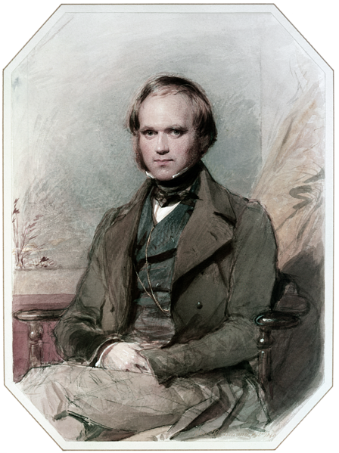
Charles Darwin (1809-1892)
HMS Beagle 1826-1831
Published Origin of Species
in 1859
Ideas of Evolution were
Common 100 years before.
Public Domain Image: http://en.wikipedia.org/wiki/File:Charles_Darwin_by_G._Richmond.png

Slide 42
What is in The Origin of the Species?
Affirms nature’s plasticity: role of breeders
Reiterates the struggle for existence (Malthus)
Infinitesimally small variations
Selection
  Sexual selection
  Role of isolation
  Natural--due to environment
Does not accept complete randomness
No statement of the origin of humans

Slide 43
Objections or Testable Hypotheses
Well ordered progression of life.
Transitional Forms
Vestiges
Residuals
Role of environment--Isolation

Slide 44
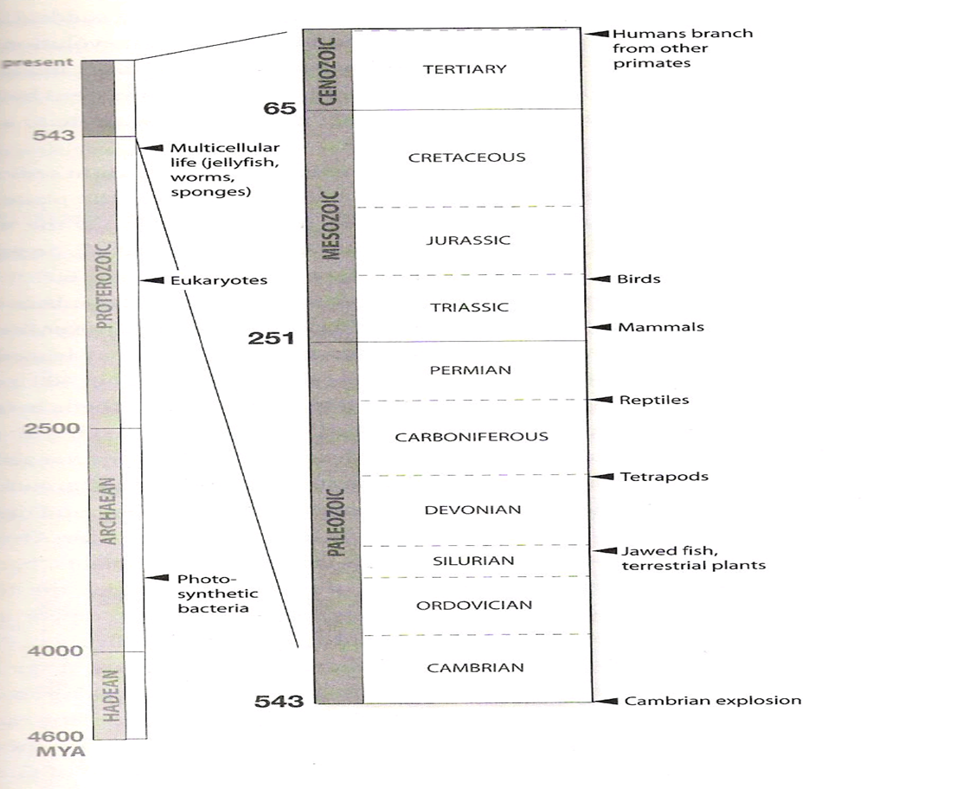
Well ordered Progression of Life
Used with permission of Jerry Coyne
(author, Why Evolution is True)

Slide 45
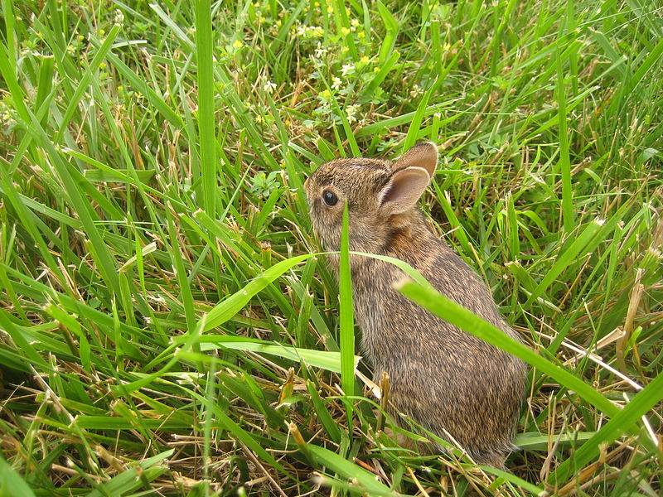
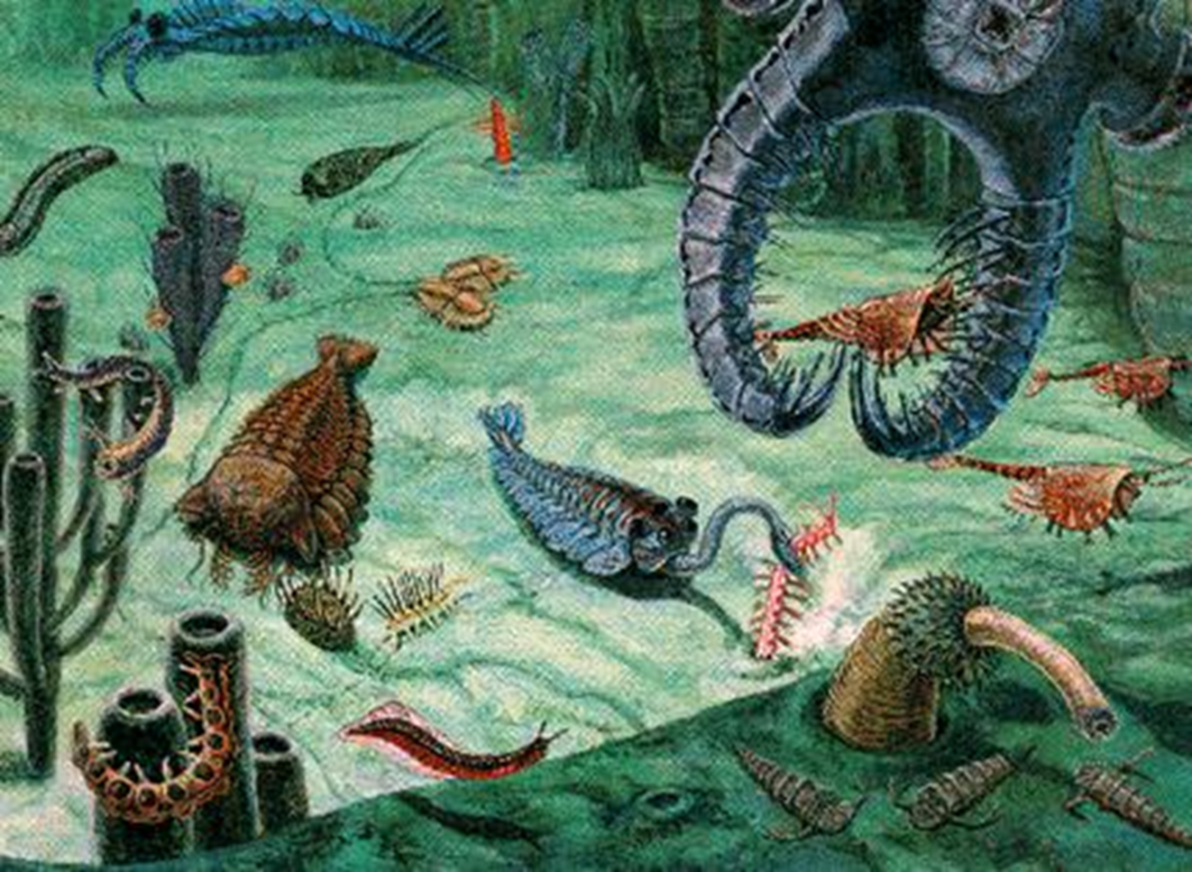
What would it take to destroy theory of evolution?
One pre-Cambrian rabbit!
Public Domain Image: http://en.wikipedia.org/wiki/File:Baby_rabbit.JPG
Image Source: http://www.astrobio.net/exclusive/3341/fossils-on-the-edge-of-forever (fair use)

Slide 46
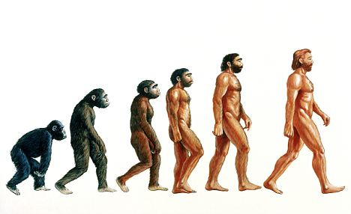
Transitional Forms
Image Source: “Out of Asia? Ancient ancestor of modern man walked Sahara 39million years ago,” David Derbyshire, 10/28/2010, MailOnline. http://www.dailymail.co.uk/sciencetech/article-1324243/Human-evolution-started-Asia-Ancient-ancestor-walked-Sahara-39m-years-ago.html (fair use)

Slide 47
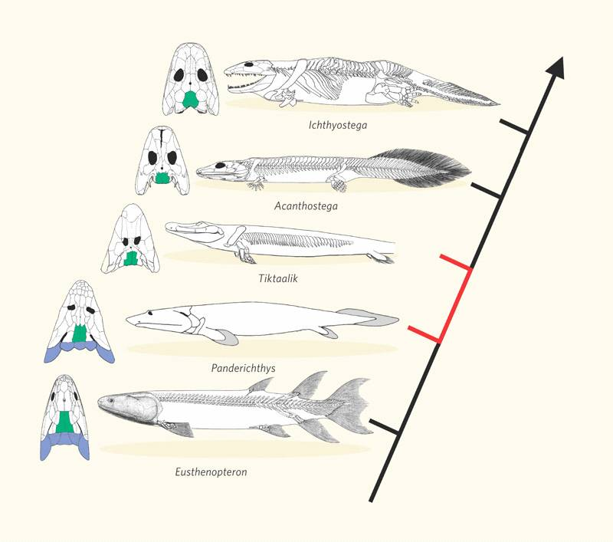
http://palaeobabbler.wordpress.com/tag/transitional-forms/ (fair use)

Slide 48
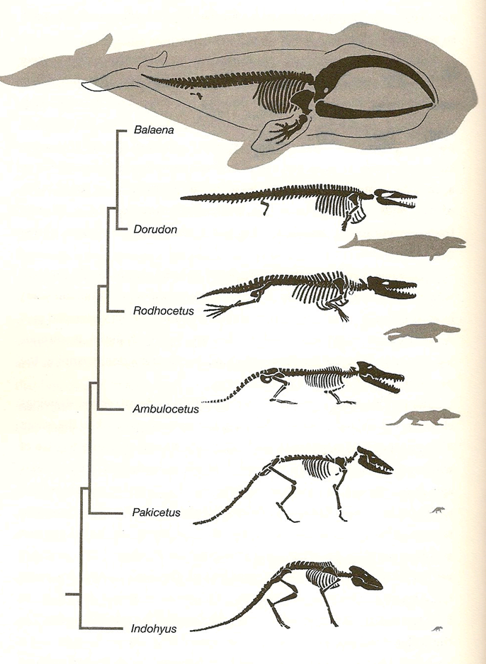
Vestiges
The evolution of whales
from land animals
illustrates changes with
only a few original
structures.
Used with permission of Jerry Coyne
(author, Why Evolution is True)

Slide 49
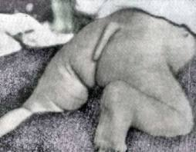
Vestige
http://antecessor.hubpages.com/hub/Unintelligent-Design-Vestiges-of-Evolution (fair use)

Slide 50
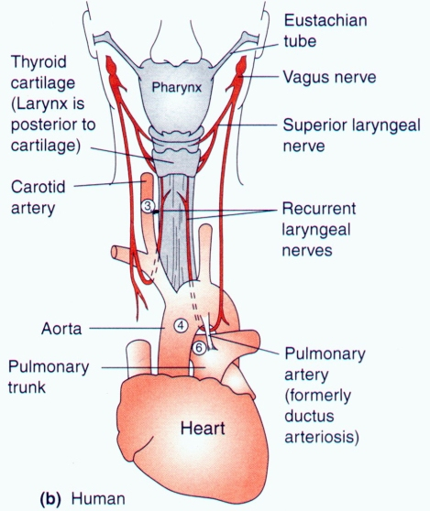
Residuals
http://whyevolutionistrue.wordpress.com/2011/05/28/the-longest-cell-in-the-history-of-life/laryngeal-nerve/ (fair use)

Slide 51
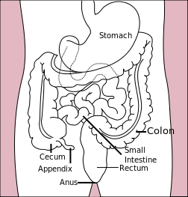
A Troublesome Residual
The Appendix
Public Domain Image: http://en.wikipedia.org/wiki/File:Stomach_colon_rectum_diagram.svg

Slide 52
Alfred Wigener
1880-1930
Proposed earths continents had moved
Based on fossil and plant similarities
Roundly rejected by most scientists
  He had no mechanism
Died in a rescue mission in Greenland
Accepted only in 1950

Slide 53
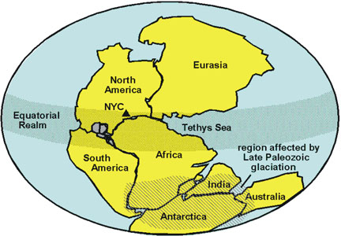
Geographic Distribution
http://3dparks.wr.usgs.gov/nyc/mesozoic/mesozoicbasins.htm (fair use)
The super-continent “Pangaea”

Slide 54
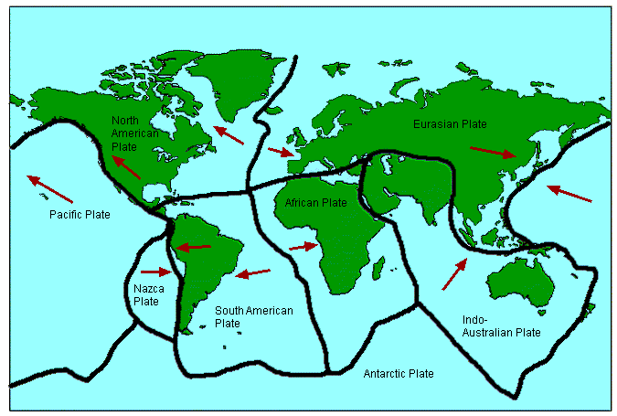
Plates Today
http://geography-site.co.uk/pages/physical/earth/tect.html (fair use)

Slide 55
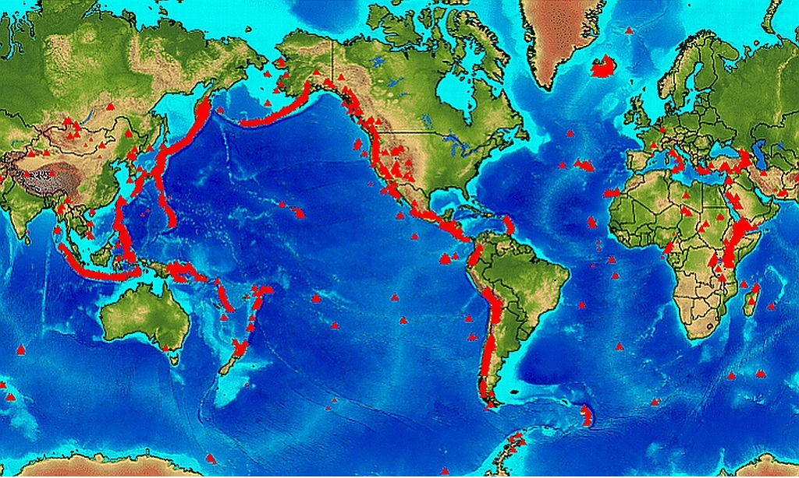
Volcanos and Earthquakes are at junctions of plates
http://bigideasroots.files.wordpress.com/2011/12/mapvolc1.jpg (fair use)

Slide 56
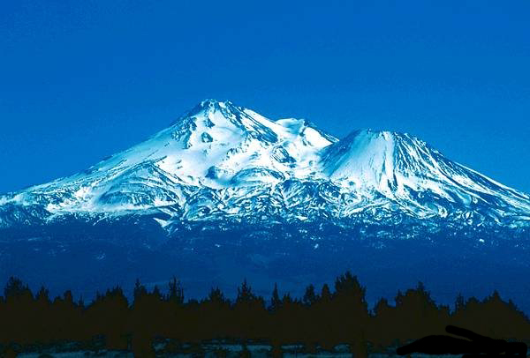
Photo courtesy of Wilton Bunch
Mt Shasta, CA Two cones formed about 10,000 years ago

Slide 57
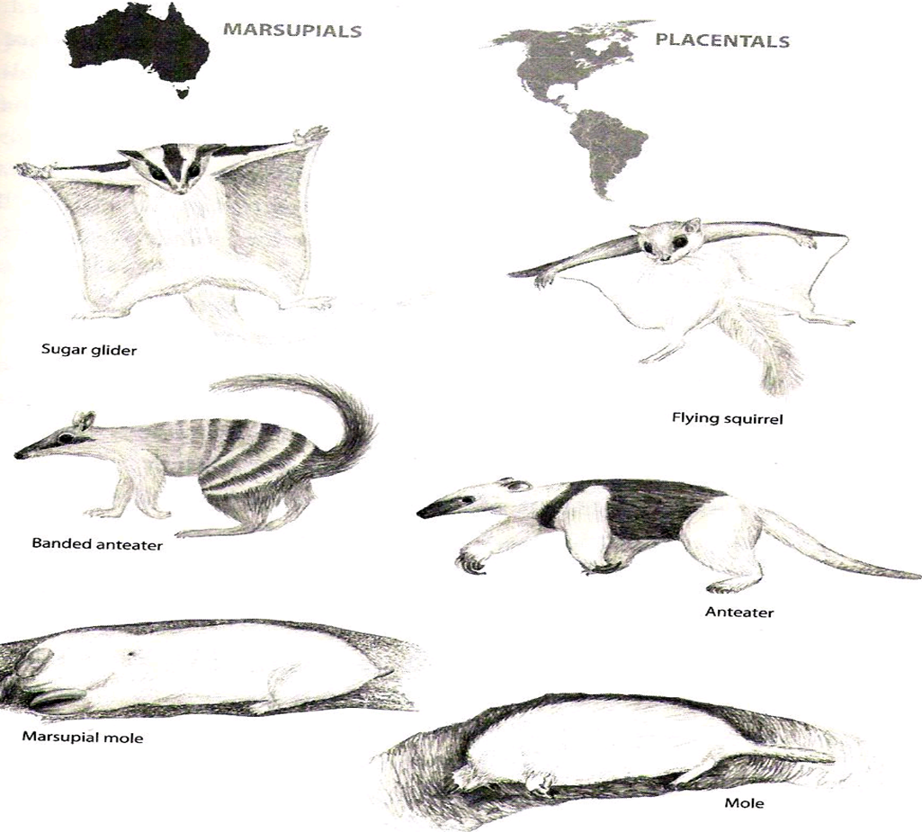
Geographic Distribution
Used with permission of Jerry Coyne
(author, Why Evolution is True)

Slide 58
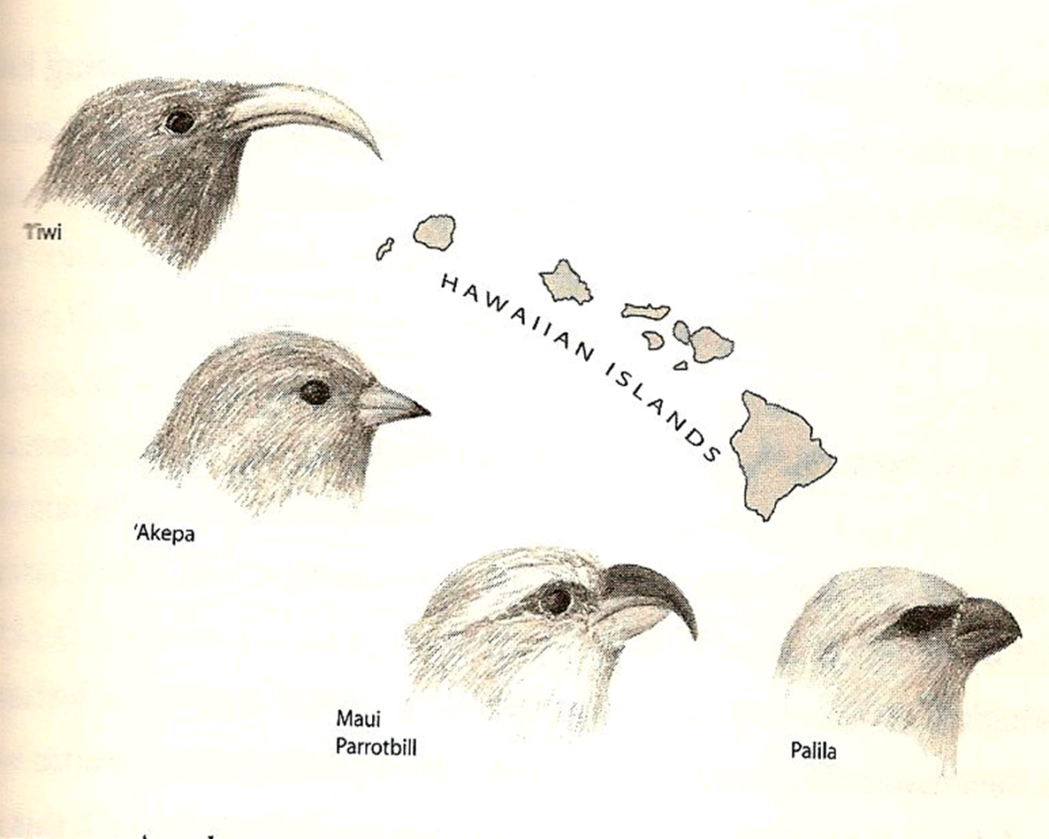
Isolation can create new species
Used with permission of Jerry Coyne
(author, Why Evolution is True)

Slide 59
Testable Hypotheses Well supported
Well ordered progression of life.
Transitional Forms
Vestiges
Residuals
Role of environment--Isolation

Slide 60
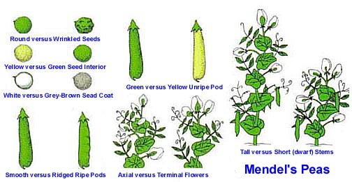
Mendel is Discovered
Image Source: Allen MacNeill, “Modern Evolutionary Synthesis” Evolutional Psychology, March 26, 2009. Posted at http://evolpsychology.blogspot.com/2009/03/modern-evolutionary-synthesis.html (fair use)

Slide 61
Molecular–Darwinian Synthesis
Change comes through genetic mutation
Some changes are good, some are bad
Natural selection eliminates the bad or mal-adaptive individuals
Change is random—selection is beneficial

Slide 62
Don’t Scientists argue about evolution?
Yes they do, but not about the big picture.
?? Is “natural” selection:
  1. random?
  2. based on kin?
  3. based on groups?
?? Slow, continuous vs explosions
Scientists do not doubt evolution happens, the debates are about the fine details.

Slide 63
Despite all the evidence from molecular biology, geography, paleoanthropology, genetics, and particularly the genome, many good Christians are deeply troubled by the apparent contradiction with Scripture.

Slide 64
How can one think about evolution and the description of creation in Scripture???
Think like a Scientist

Slide 65
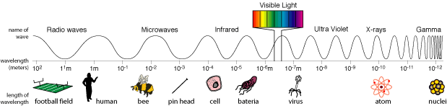
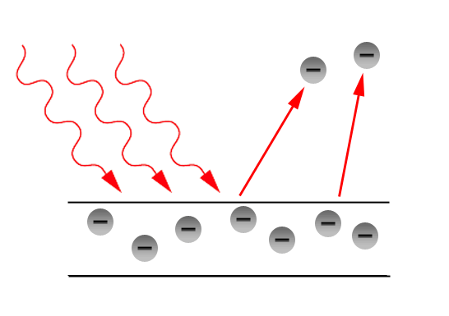
Thinking like a Scientist I.
Waves and Particles
Consider Light
e=hf
Light is a wave, part of the
Electromagnetic spectrum
Image Source: http://science.hq.nasa.gov/kids/imagers/ems/index.html (fair use)
Light is a particle
Producing the Photoelectric
Effect
http://www.physicsforums.com/library.php?do=view_item&itemid=30do=view_item&itemid=30 (fair use)

Slide 66
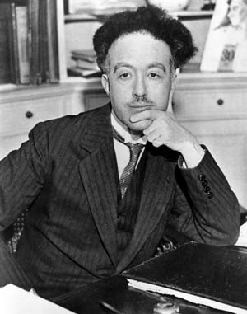
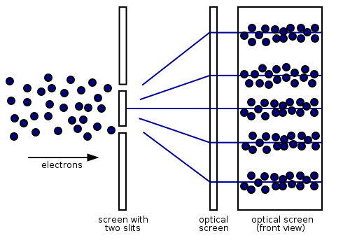
Louis de Broglie
1892-1987
Public Domain Image: http://en.wikipedia.org/wiki/File:Broglie_Big.jpg
http://en.wikibooks.org/wiki/Materials_in_Electronics/Wave-Particle_Duality/The_Two-Slit_Experiment/Electrons (fair use)
Electrons (particles) have wave characteristics
Now shown that particles as large as 60 carbons have waves

Slide 67
“Two seemingly incompatible conceptions can each represent an aspect of the truth. . . they may serve, in turn, to represent the facts without ever entering into direct conflict.”
Louis de Broglie

Slide 68
Apostolic Era
Who was this man called The Christ?
Alexandria: He must have been a god.
Antioch: He must be a man, a very special man, but a man.
Congregations divided, friends fought, leaders were exiled and some killed.

Slide 69
The Two Natures of Christ
We believe in one Lord, Jesus Christ,
the only Son of God,
eternally begotten of the Father,
God from God, Light from Light,
true God from true God.
    . . . . . . .
By the power of the Holy Spirit
he became incarnate from the Virgin Mary, and was made man. Nicene Creed

Slide 70
Bible gives a divine message about God and who God is.
Nature gives a message about what God has done.
“…facts without ever entering into direct conflict.”

Slide 71
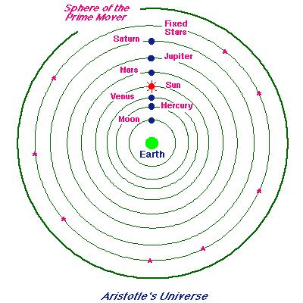
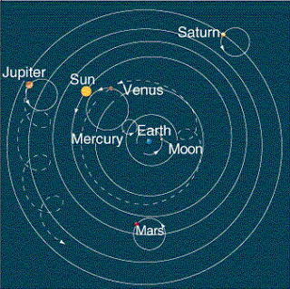
Thinking Like a Scientist II.
Description vs. Explanation
Some theories are solely description
http://csep10.phys.utk.edu/astr161/lect/retrograde/aristotle.html (fair use)
http://ajadskim.blogspot.com/2011_02_01_archive.html (fair use)
Aristotle
Ptolemy

Slide 72
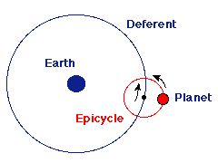
Ptolemy did not believe the epicycles really existed
Necessary to explain retrograde planetary motion
http://csep10.phys.utk.edu/astr161/lect/retrograde/aristotle.html (fair use)

Slide 73
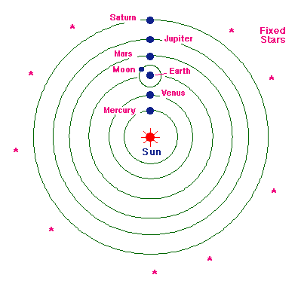
Copernicus
http://csep10.phys.utk.edu/astr161/lect/retrograde/copernican.html (fair use)
Believed this to be explanation, not merely description

Slide 74
Dissention and Discord immediately broke out.
Osiander wrote unsigned preface of Copernicus’ book saying “Description”
Jesuits taught the book was Description, but made calculations much easier.
Galileo had no doubts that it was Explanation

Slide 75
Quantum Physics: Virtual Particles
Particles appear, disappear, re-appear but changed, even from “empty space.”
These are descriptions from experiments and equations, but have no explanation.

Slide 76
Incarnation & Resurrection
We have no naturalistic explanations for these marvelous events in the life of Christ. They can be considered to be descriptions.
Like scientists, people of faith do not need to be embarrassed by accepting and believing a description.

Slide 77
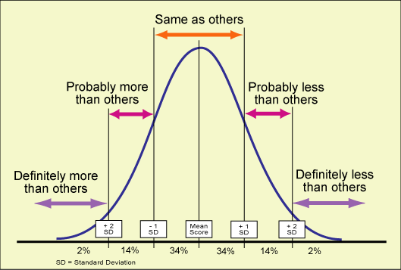
Thinking Like a Scientist III.
Recognize possibility of error
“I may be wrong, but I’m not in doubt.”
Always recognize there is the possibility of being wrong.
http://classes.kumc.edu/sah/resources/sensory_processing/learning_opportunities/sensory_profile/bell_curve.htm (fair use)

Slide 78
Karl Barth
“Any time you believe you have the complete truth about God you have made yourself into a god and violated the second commandment.”
No matter how seriously and prayerfully we think about God, there always is the possibility we are wrong.

Slide 79
Thinking Like a Scientist
1. Recognize that explanations that seem to be contradictory might both be true.
2. Sometimes description is all we can achieve and we do not need to be embarrassed by lack of natural explanation.
3. Be humble about conclusions

Slide 80
Our Conclusions
“Christian” refers to one who is in relationship with Jesus Christ.
The term has nothing to do with concepts or beliefs of the mechanism of creation.
It is perfectly possible for a Christian to believe God created our earth and still accept Evolution.

Slide 81
Our Conclusions
“Two seemingly incompatible conceptions can each represent an aspect of the truth. . . they may serve, in turn, to represent the facts without ever entering into direct conflict.”
Louis de Broglie

Slide 82
Our Conclusions
The Theory of Evolution does not rule out that our earth developed by the decisions and actions of God.

Slide 83

Our Conclusion
Science and Religion are not necessarily in conflict even in this most sensitive question: “How did we get here?”
Photo courtesy of Wilton Bunch

Slide 84
Where Did We Come From?
Wilton Bunch, M.D., Ph.D.
Samford University
Conditions of Use
The slides contained in this presentation and the accompanying notes are freely available for use and/or modification by individuals and groups to promote understanding and dialogue in science and religion with the stipulation that they may not be sold or traded individually, collectively, or otherwise for any form of financial or material gain. The source of all images in this collection of slides is either noted directly (if required by the author) or may be viewed by clicking an image (in edit mode) and then clicking “Send to Back.” These forms of crediting images must be included in any use or derivation of these materials.
The contents of these slides and the accompanying notes reflect the views of the author and should not be assumed to represent the position of Samford University or its employees.

